Slide 1
Introduction to Computing for Data Analysis
Does my (numerical) program compute the right answer?
Richard Vuduc, Ph.D.
Associate Professor
School of Computational Science and Engineering
Computing a sum, part 3: Error analysis
Notes:
Hi, I see you are back for more!
We are almost done with this summation example.
Let’s start by recapping the analysis so far and then do the next step, which is a backward error analysis.

Slide 2
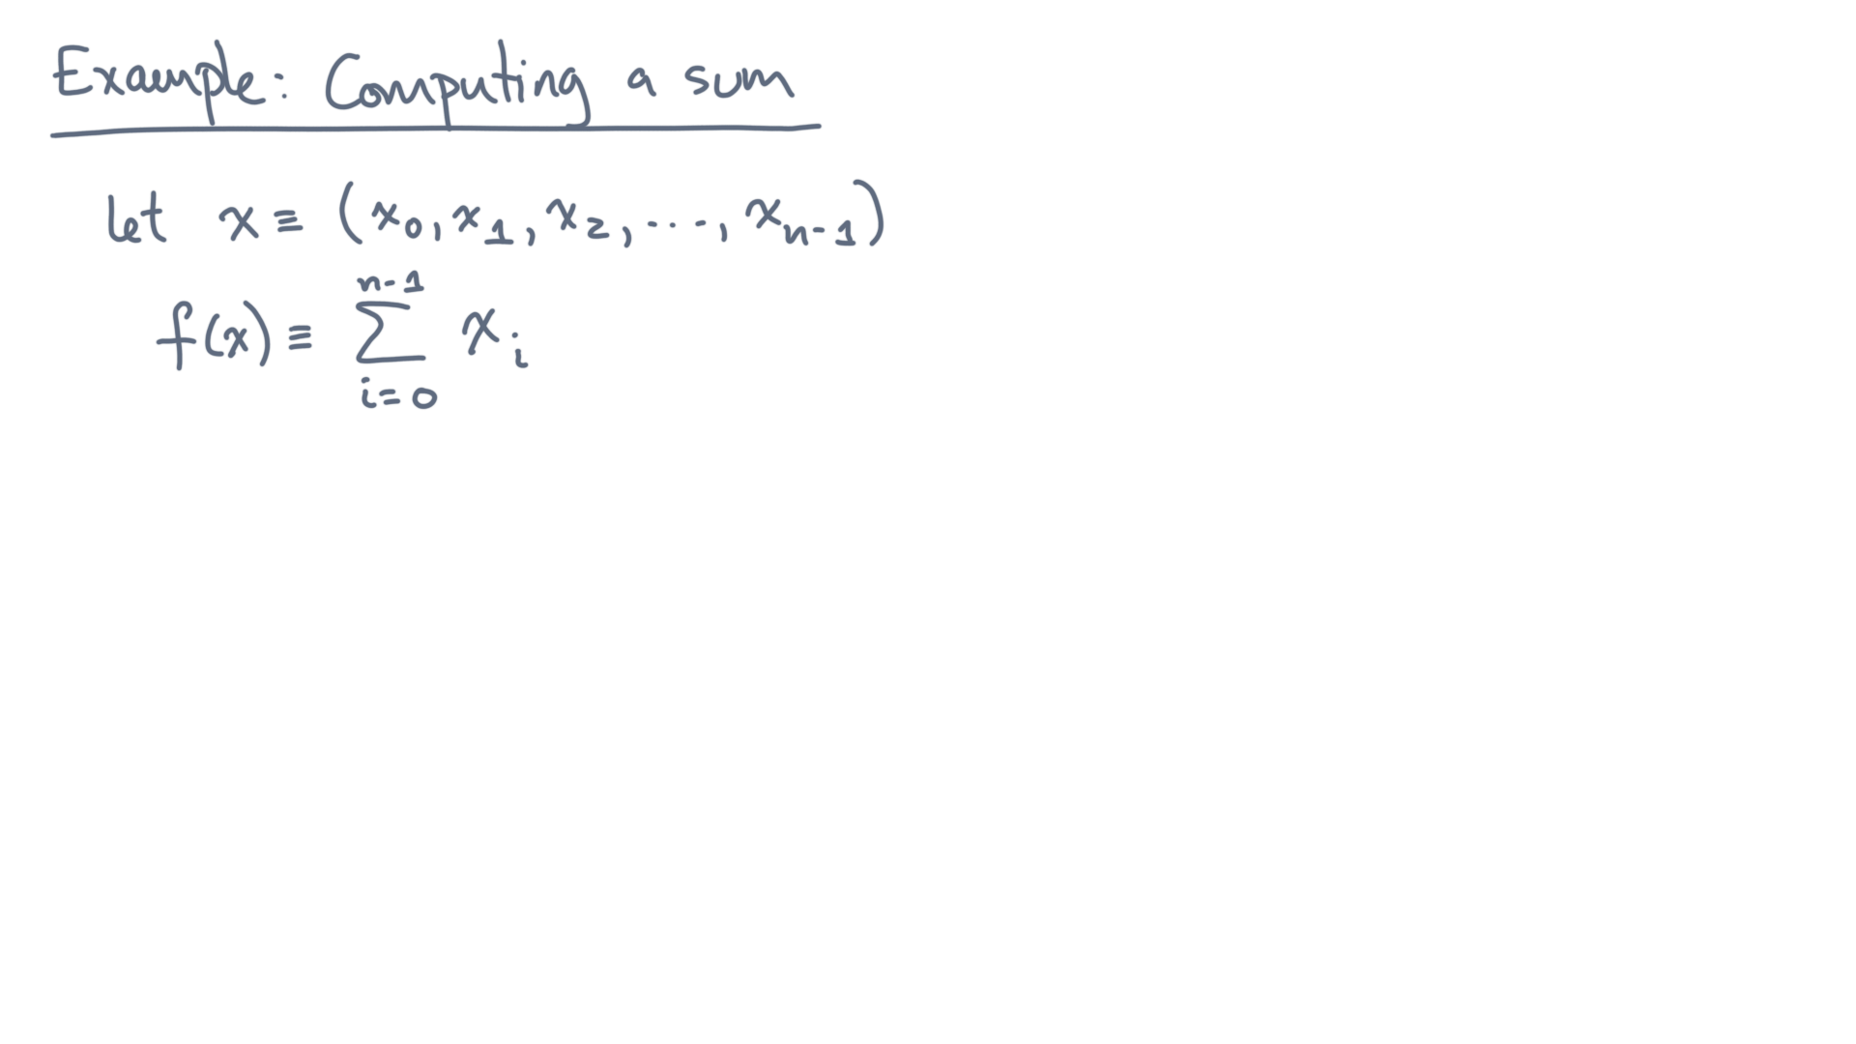
Notes:
Recall that the problem is to sum a collection of values, x-zero through x-n-minus-one.

Slide 3
def alg_sum(x):
s = 0.0
for x_i in x:
s += x_i
return s
Notes:
And as a reminder, here is the algorithm you analyzed.
And here is what you showed:

Slide 4
def alg_sum(x):
s = 0.0
for x_i in x:
s += x_i
return s
Notes:
And as a reminder, here is the algorithm you analyzed.
And here is what you showed:

Slide 5
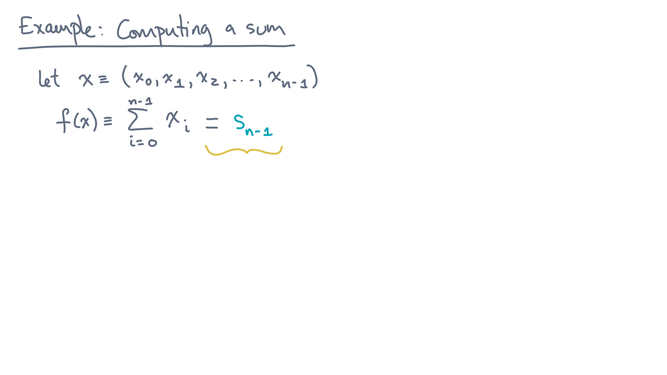
Notes:
Denote the exact sum by s-sub-n-minus-one.

Slide 6
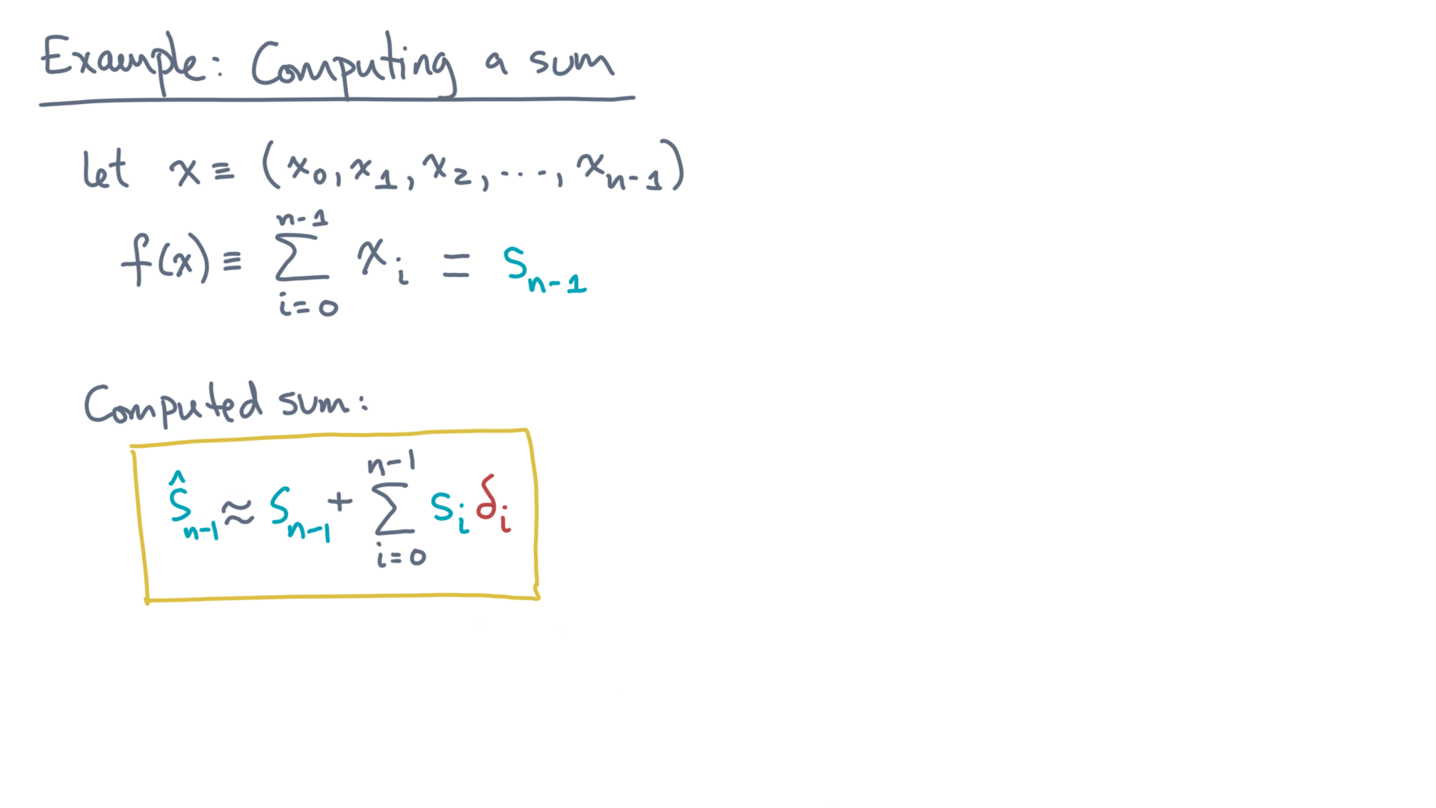
Notes:
Then the *computed sum*, s-hat-sub-n-minus-one, is the exact sum plus a perturbation.
This perturbation is first order in the individual rounding errors.

Slide 7
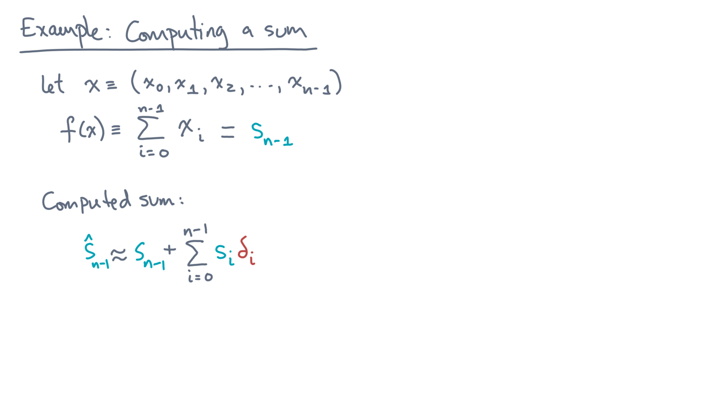
Notes:
So is that good or bad?
Well, that’s the question is what motivates either a forward or backward analysis.

Slide 8
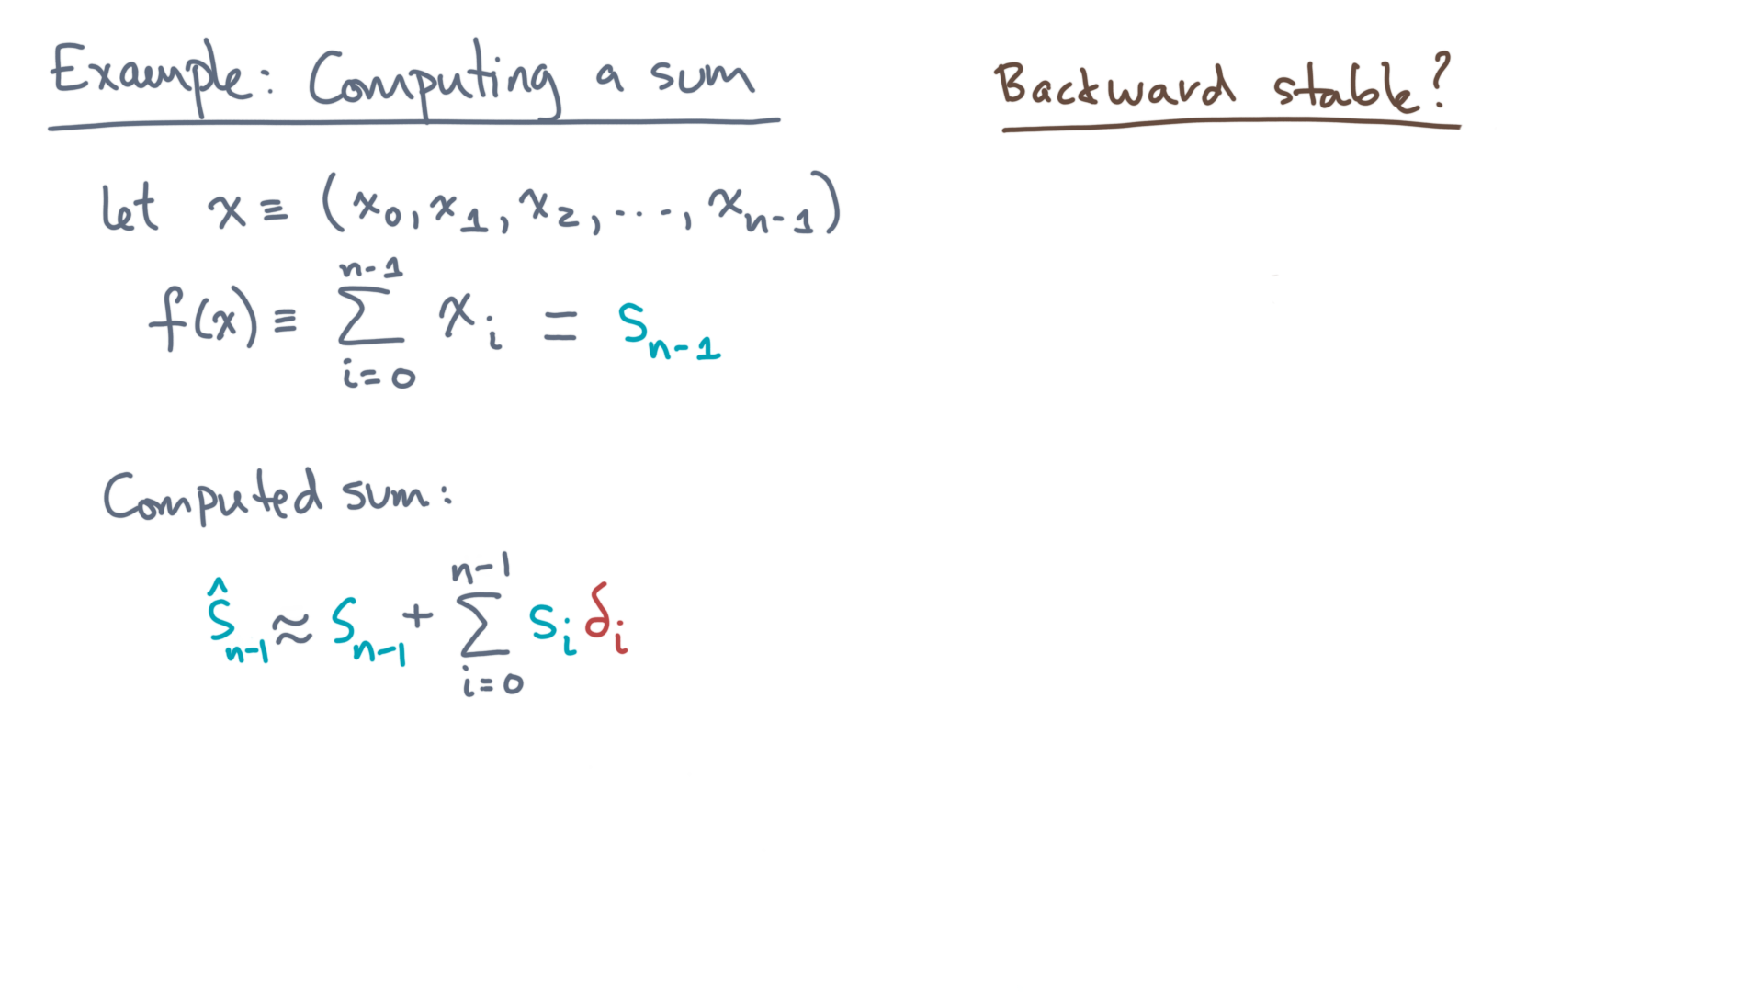
Notes:
Though we can do either, let’s try to do a backward stability analysis.
Remember what that means.

Slide 9
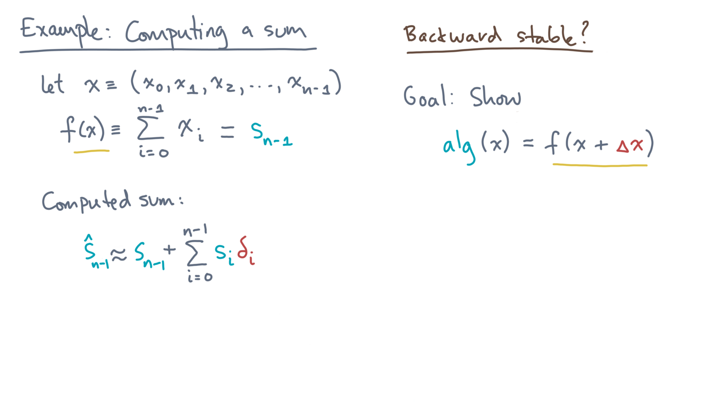
Notes:
The algorithm produces the exact answer to a *slightly different* problem.

Slide 10
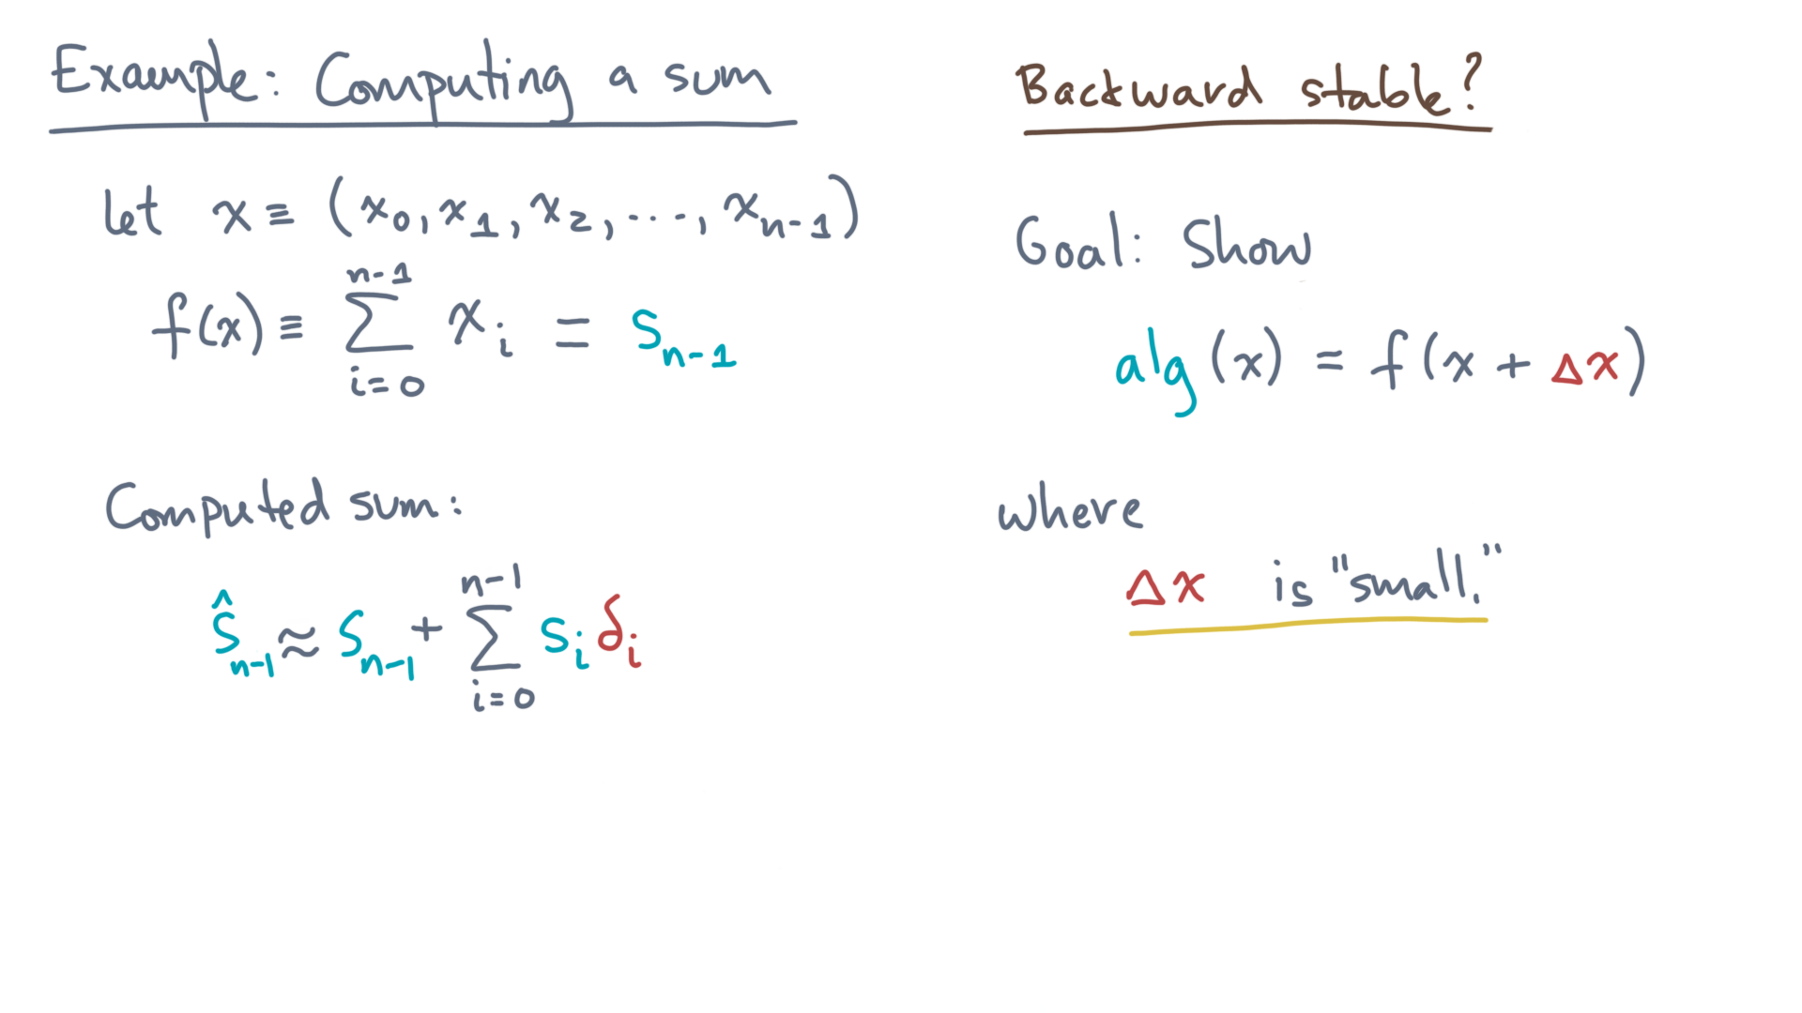
Notes:
The keyword is “slightly.”
In other words, the equivalent perturbation to the input should be small, whatever “small” means.

Slide 11
Notes:
So how should we begin?

Slide 12
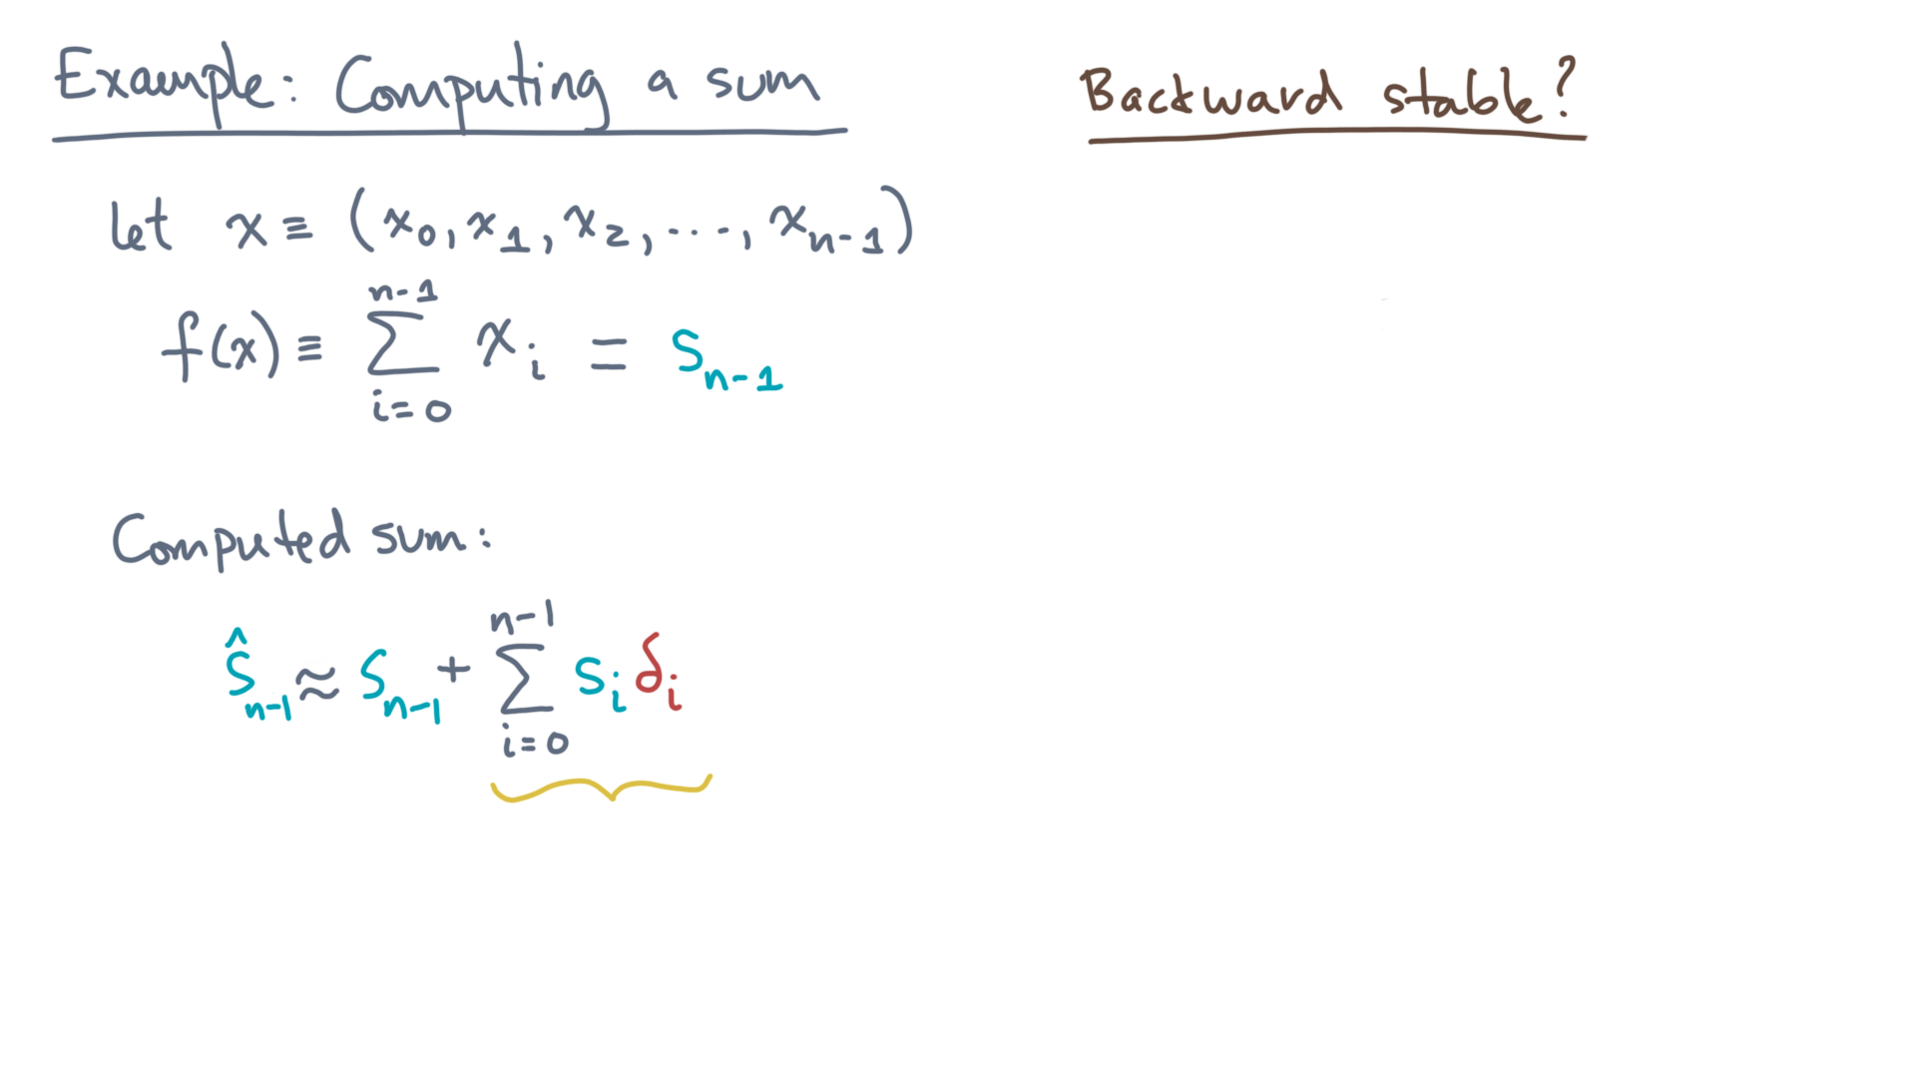
Notes:
Let’s focus on this summation term of the computed sum.

Slide 13
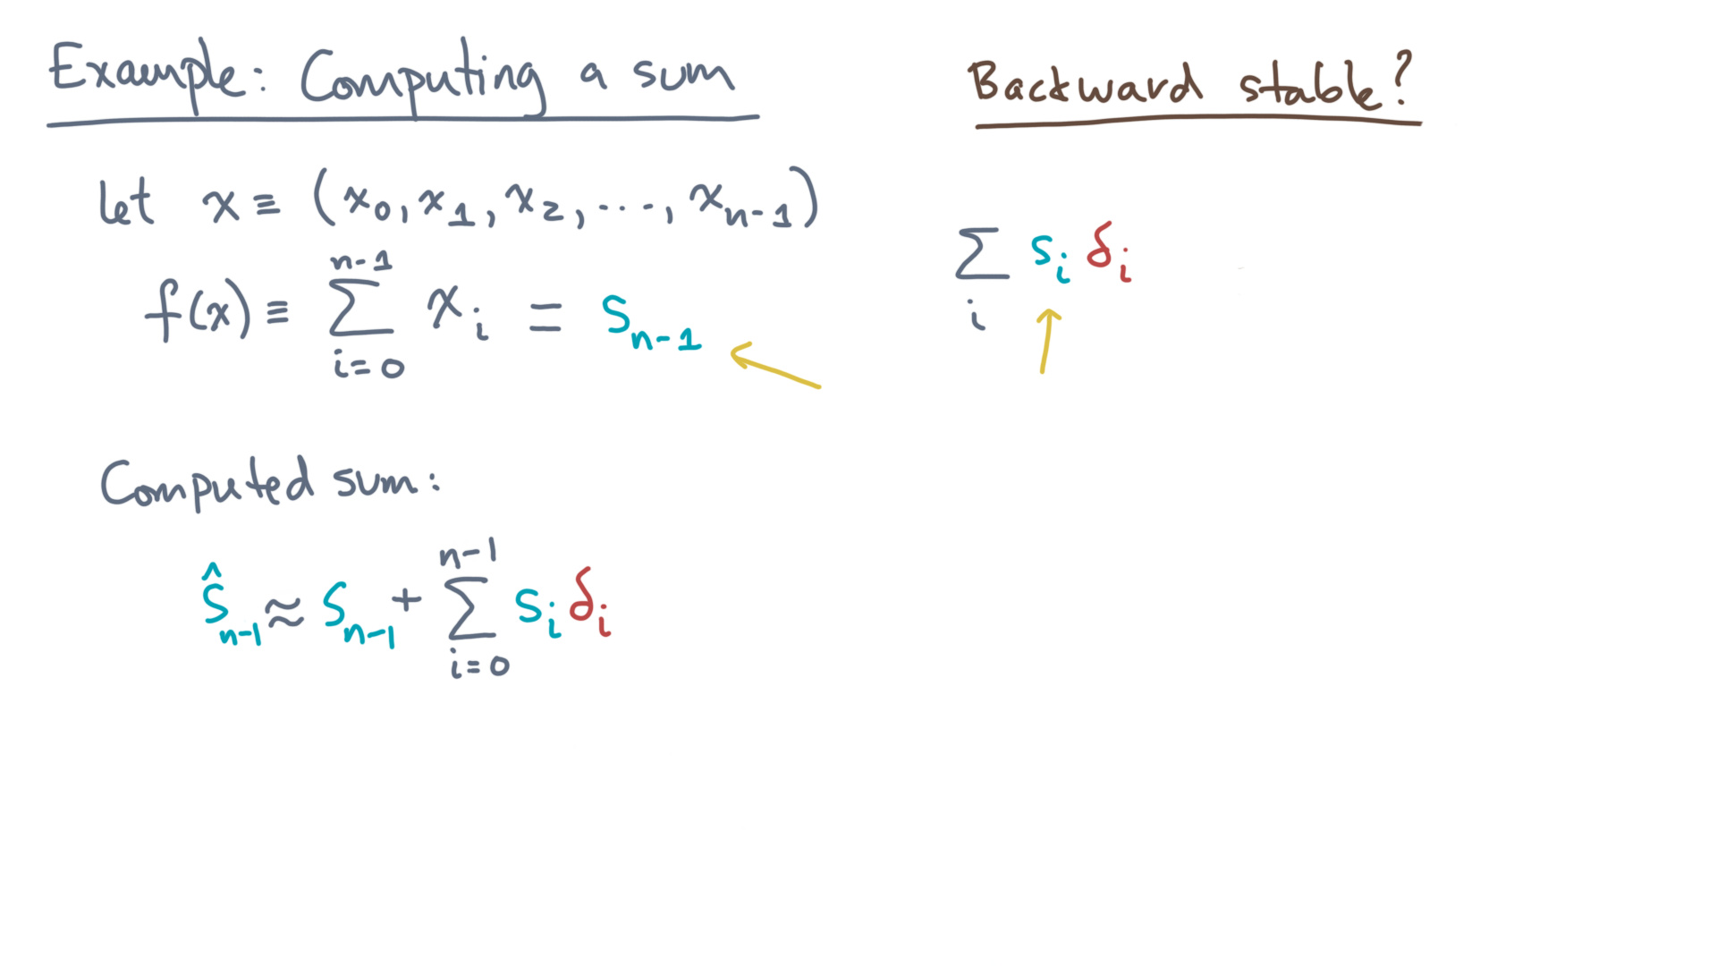
Notes:
Start by replacing s-sub-i with its definition.

Slide 14
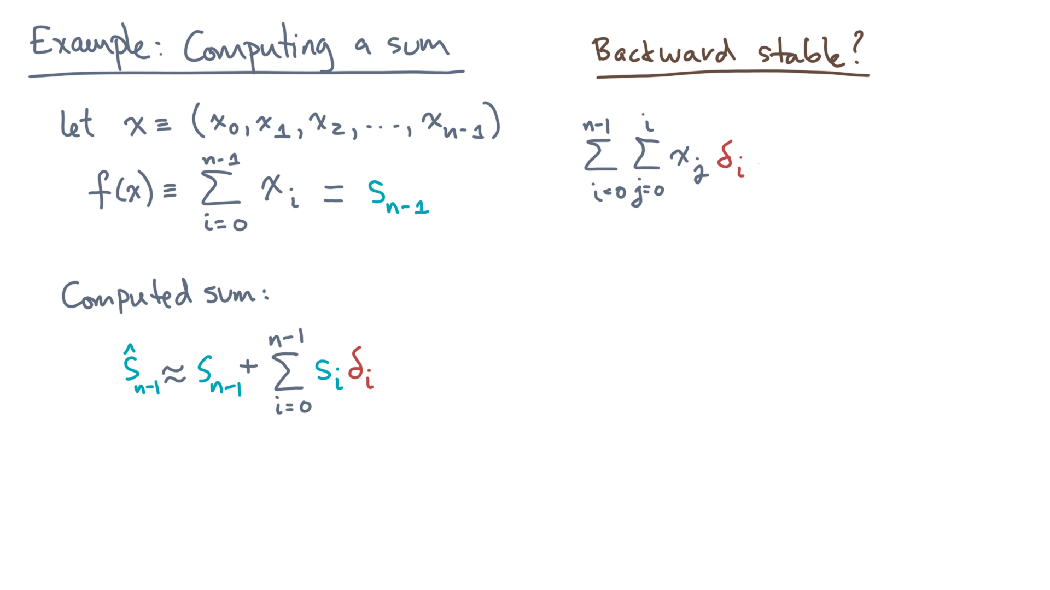
Notes:
The result is a double sum of the products, x-jay and delta-i.
The i-index ranges from 0 to n-minus-one, and the j-index from 0 to i.

Slide 15
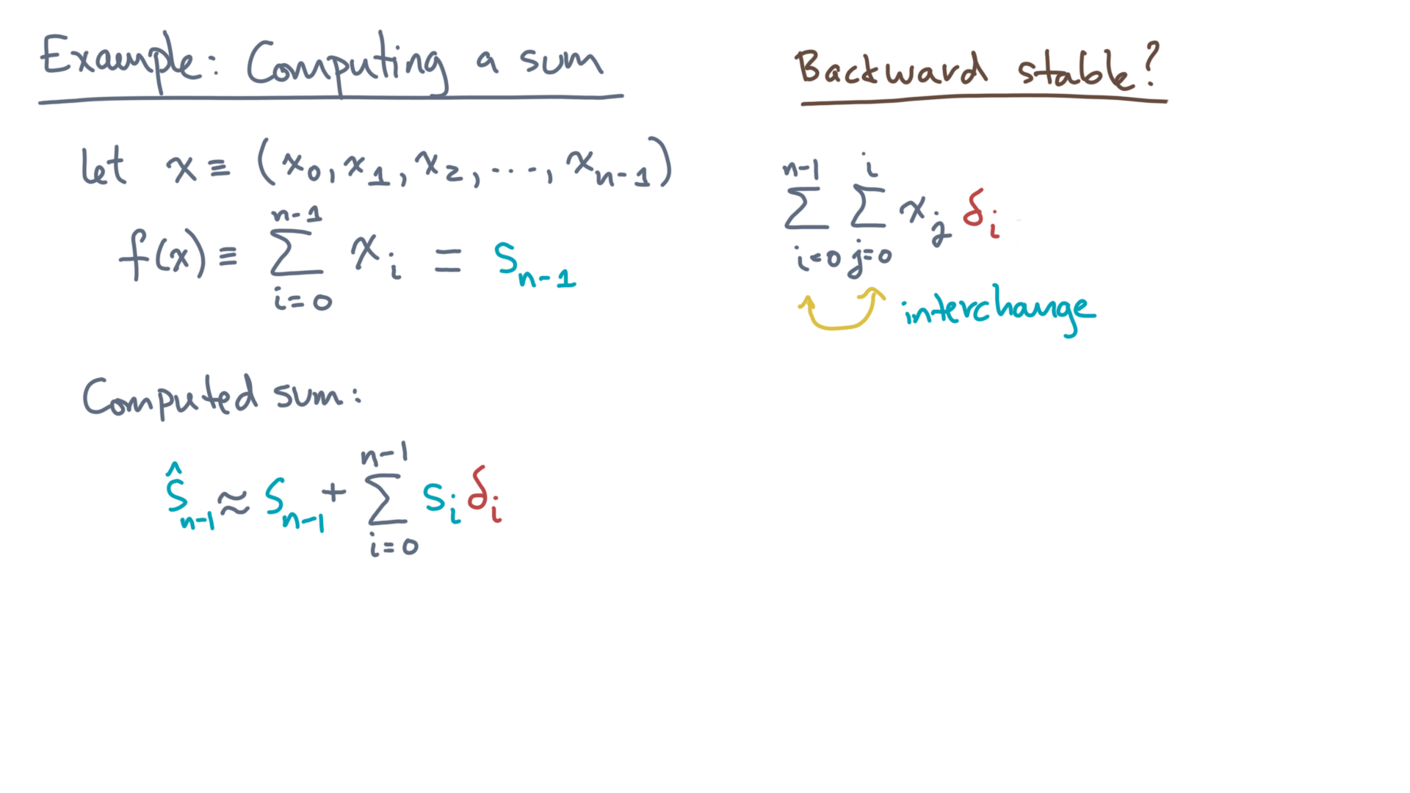
Notes:
Let’s try to pull the “x” variables out by interchanging this sum.
One way to see how is to expand the double sums.

Slide 16
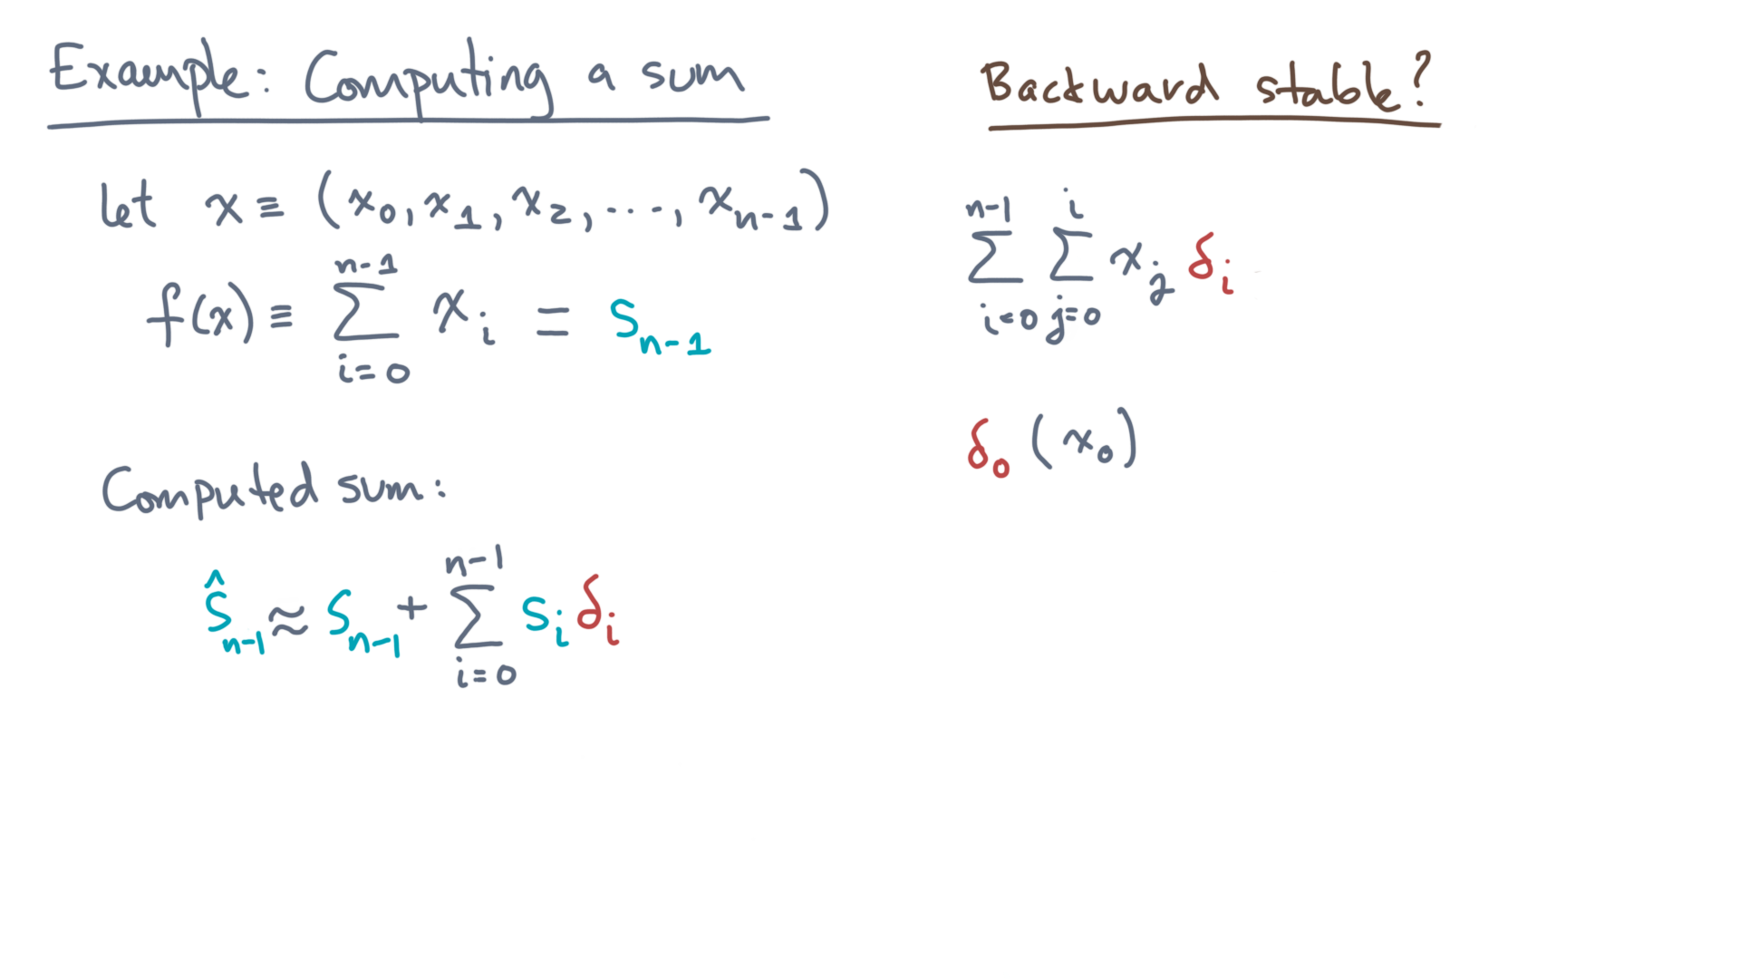
Notes:
When i is zero, there is just a delta-zero times x-zero.

Slide 17
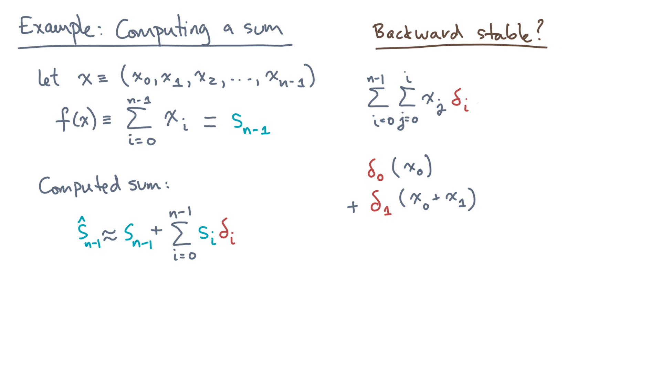
Notes:
i equals one adds delta-one times the quantity x-zero plus x-one.

Slide 18
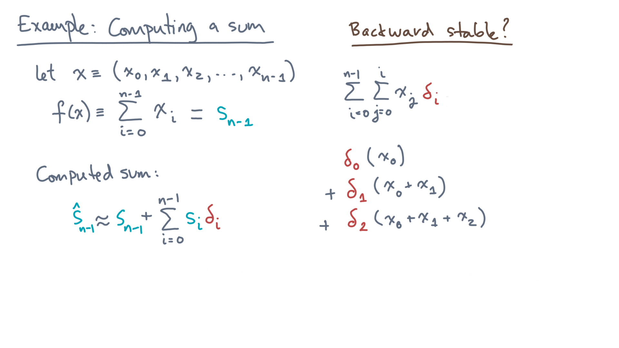
Notes:
i equals to adds delta-two times the sum of x0 plus x1 plus x2.

Slide 19
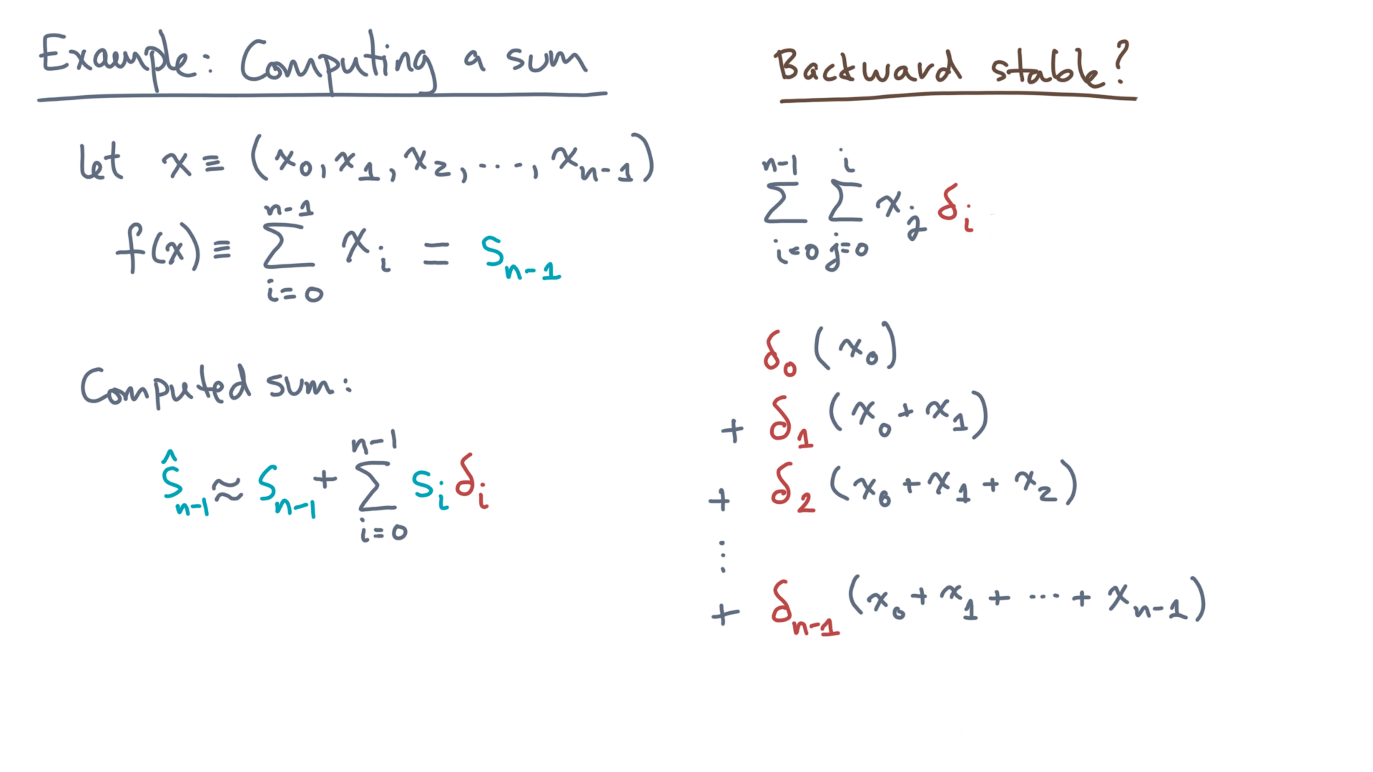
Notes:
You can see the pattern from here.
Notice that x-zero gets multiplied by every delta.

Slide 20
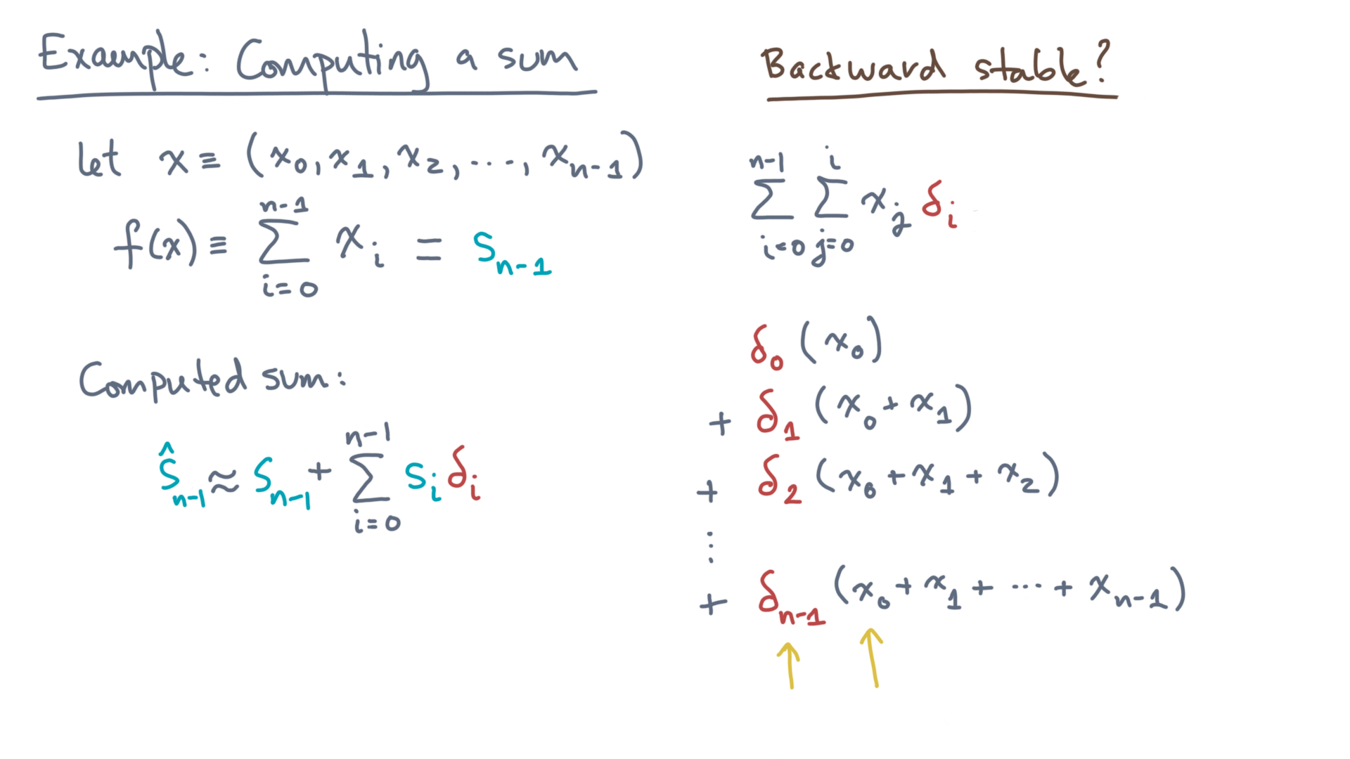
Notes:
Similarly, x1 gets multiplied by every delta starting from delta-one.

Slide 21
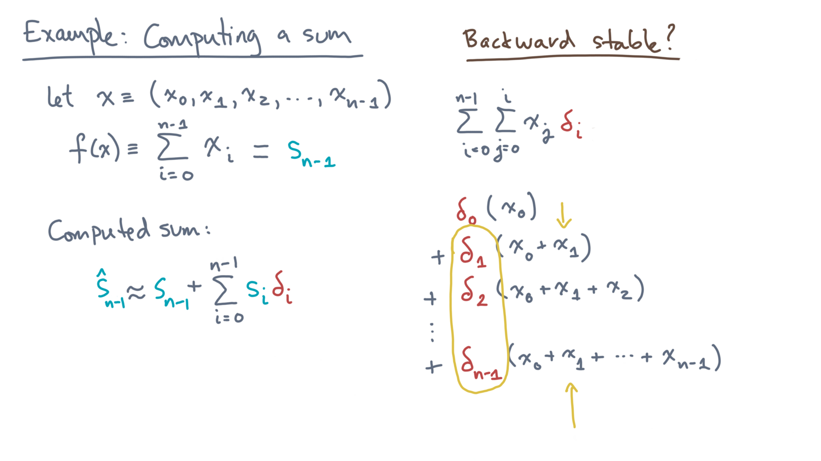
Notes:
Thus, we can rewrite the double sums as follows.

Slide 22
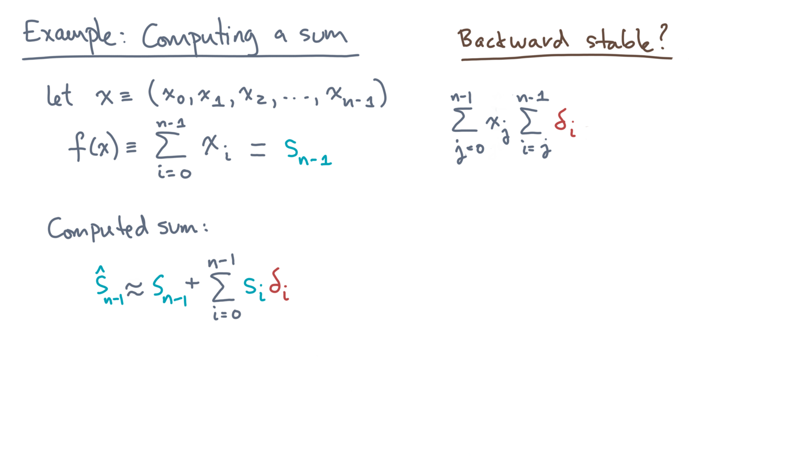
Notes:
An outer sum over j of x-j times an inner sum over i, starting at j, of delta-i.

Slide 23
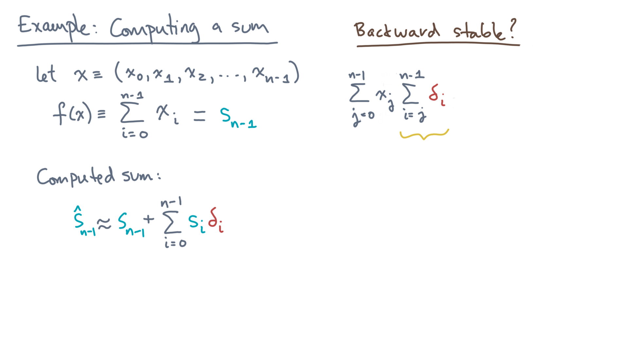
Notes:
Let’s simplify this a little by defining a new variable for the inner sum.

Slide 24
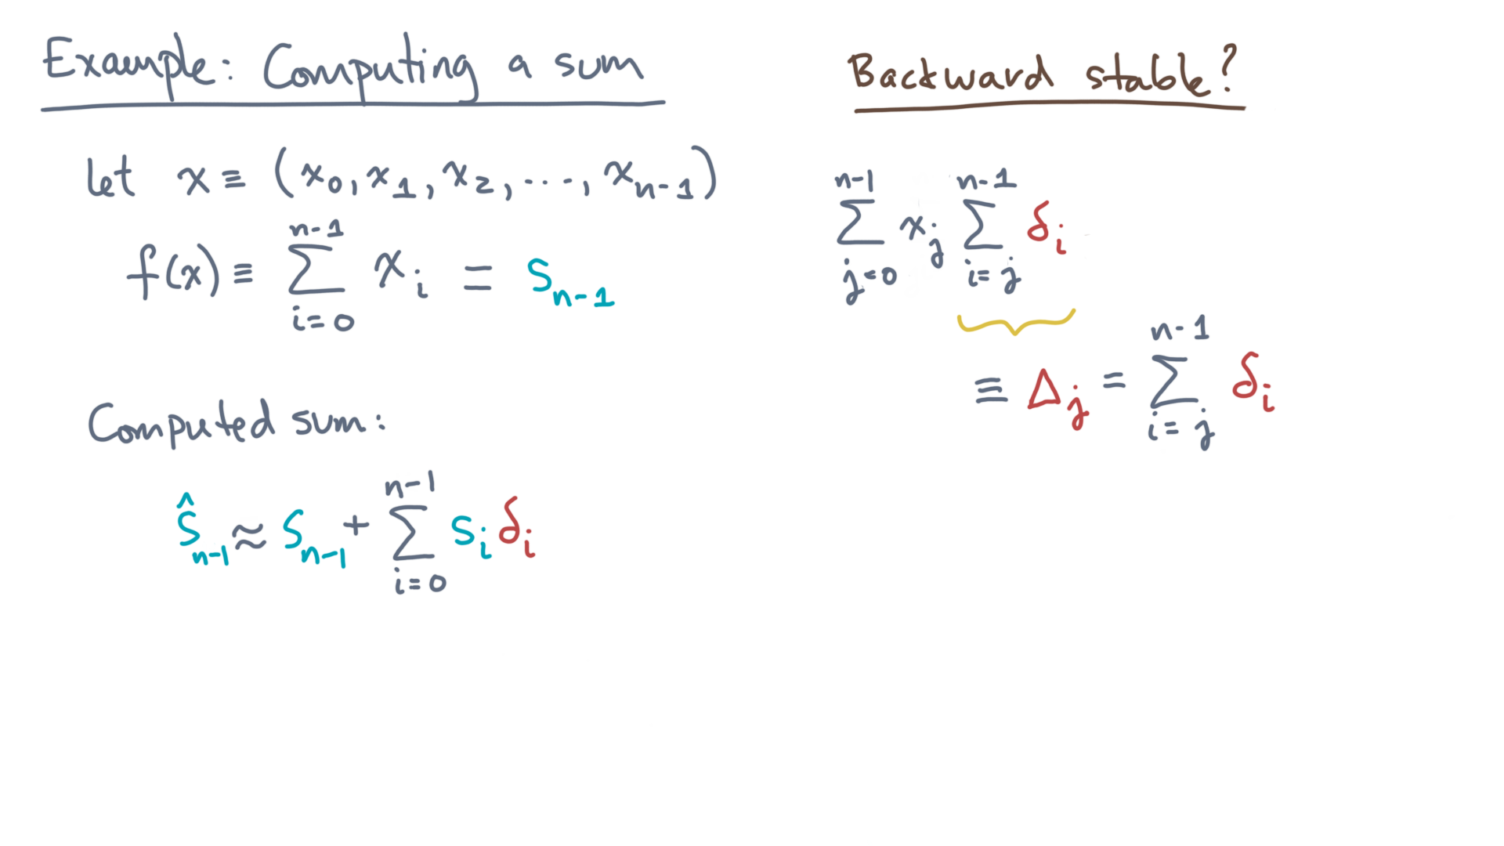
Notes:
Let capital Delta-j denote the inner sum.

Slide 25
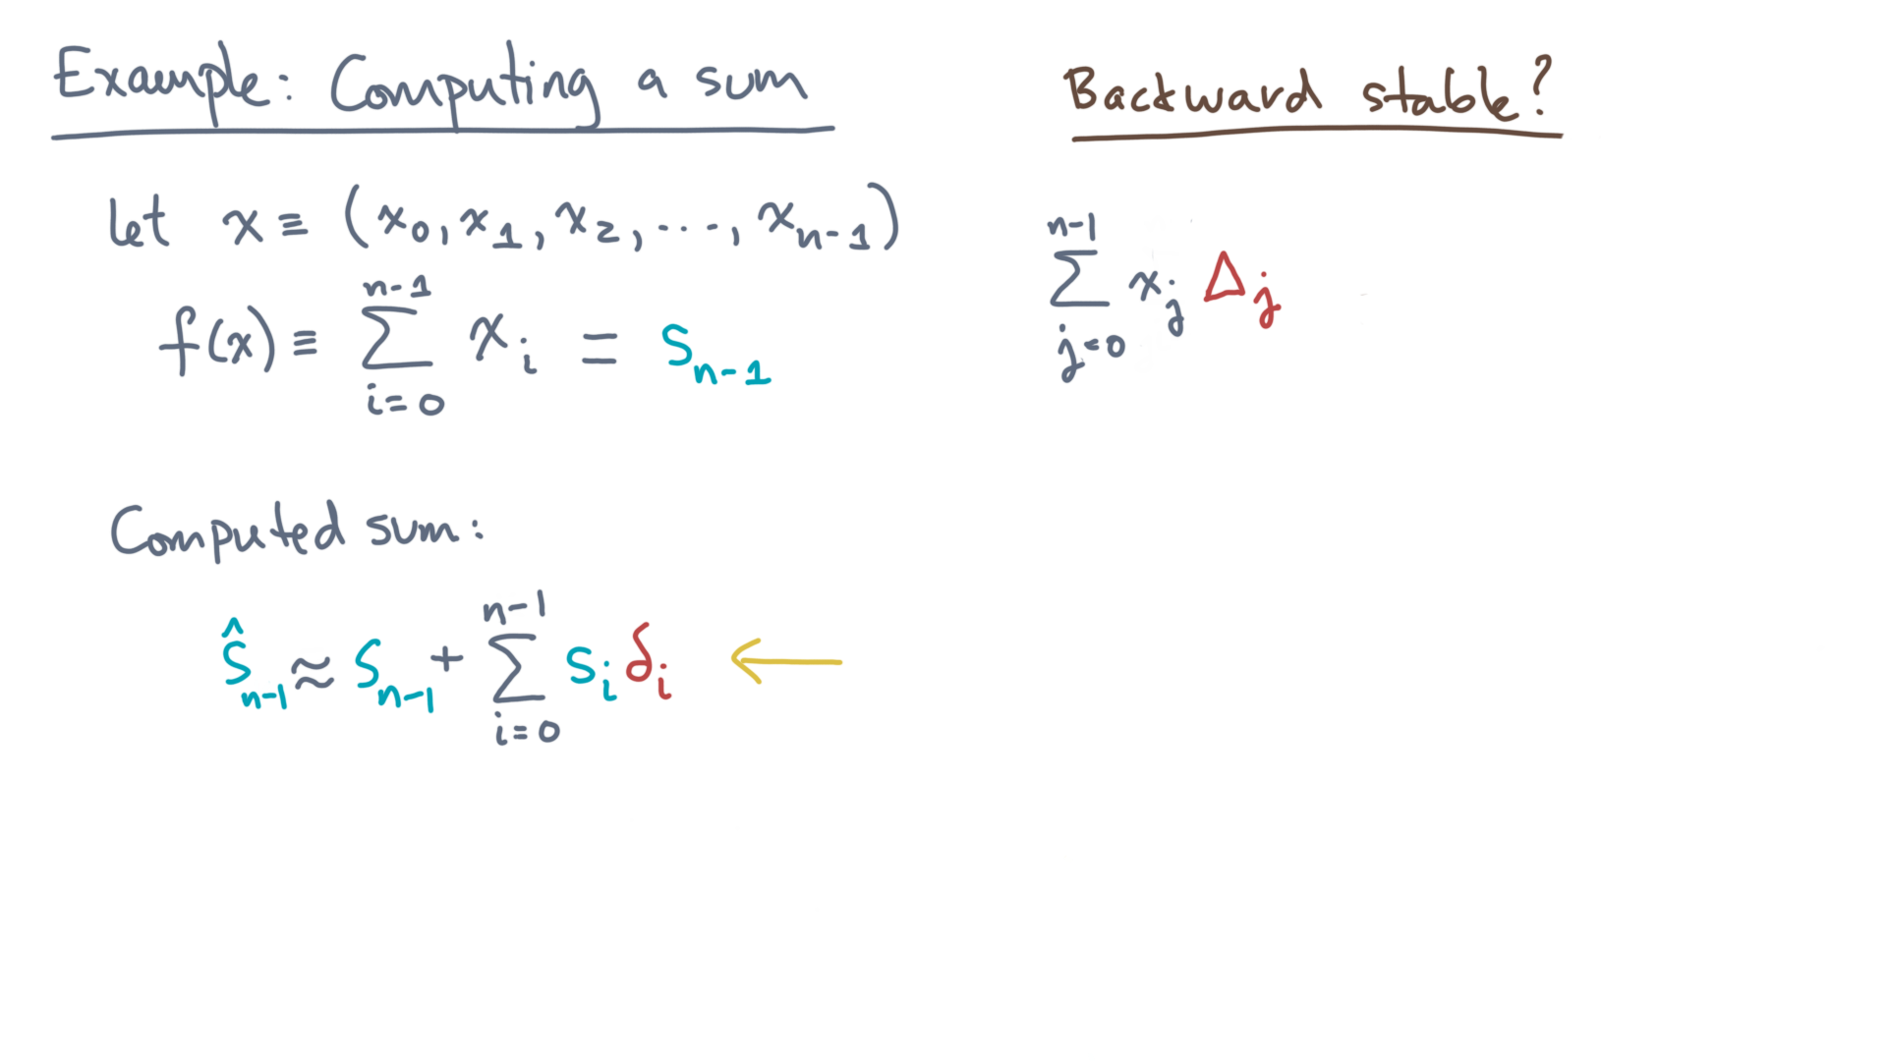
Notes:
We can now substitute this expression back into the formula for the computed sum.

Slide 26
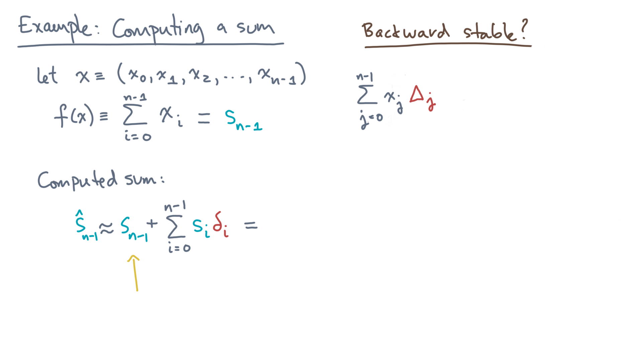
Notes:
Since our new expression is written in terms of the elements of x, let’s first rewrite the exact term.

Slide 27
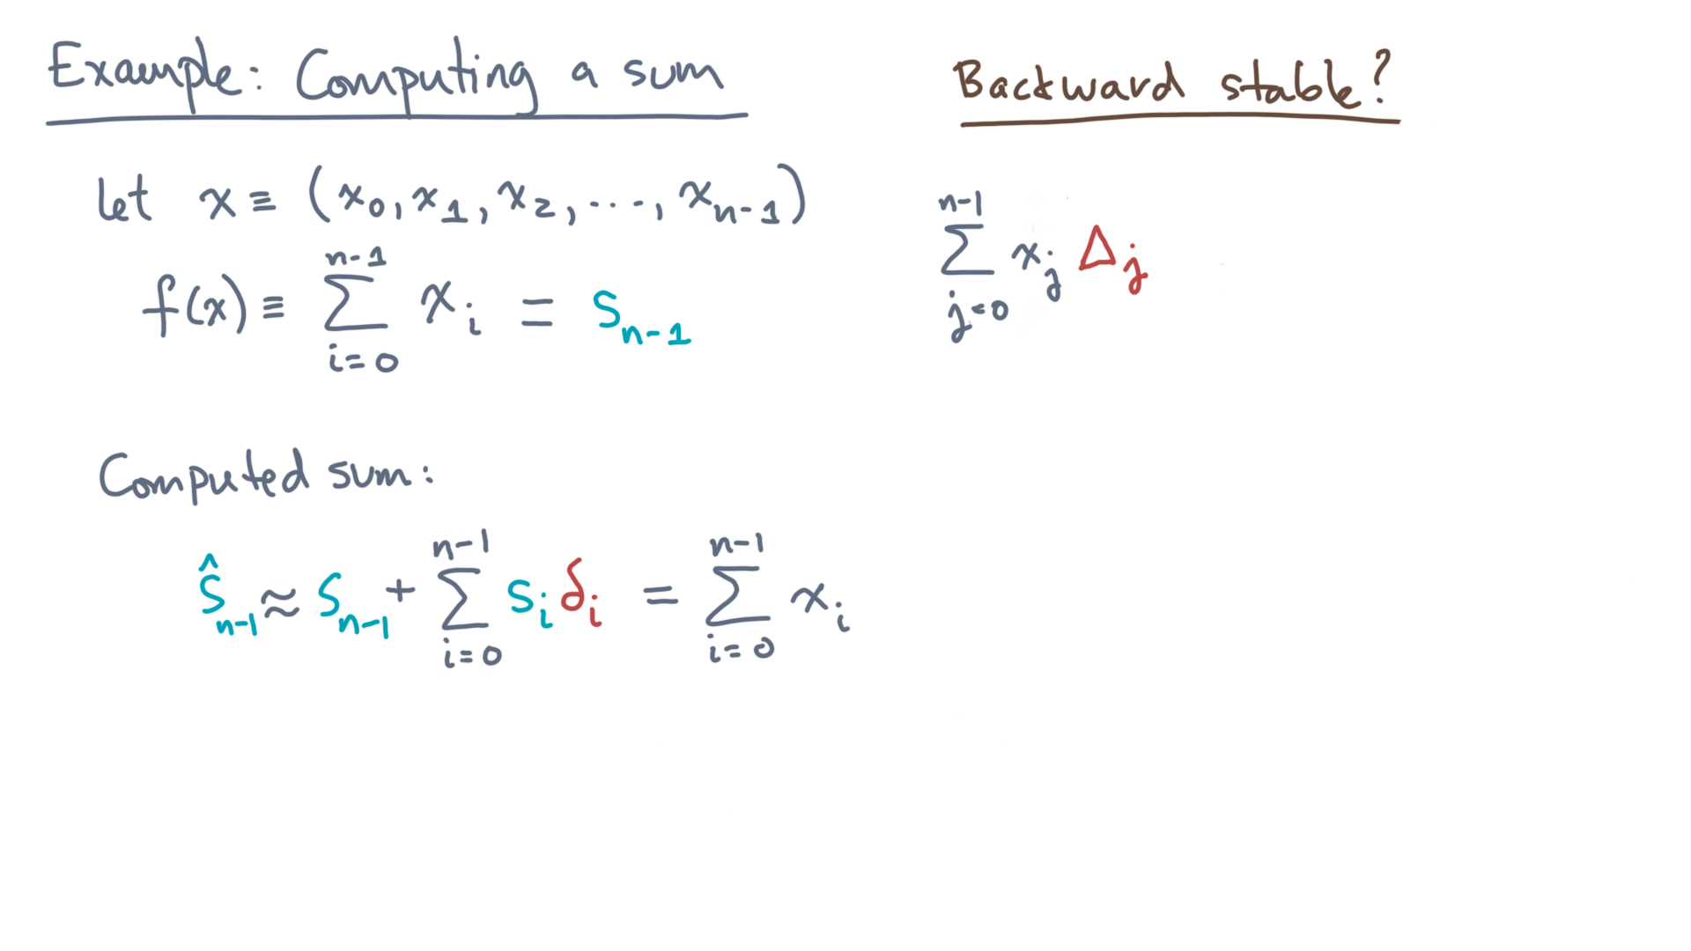
Notes:
Now replace the error term that we derived earlier.

Slide 28
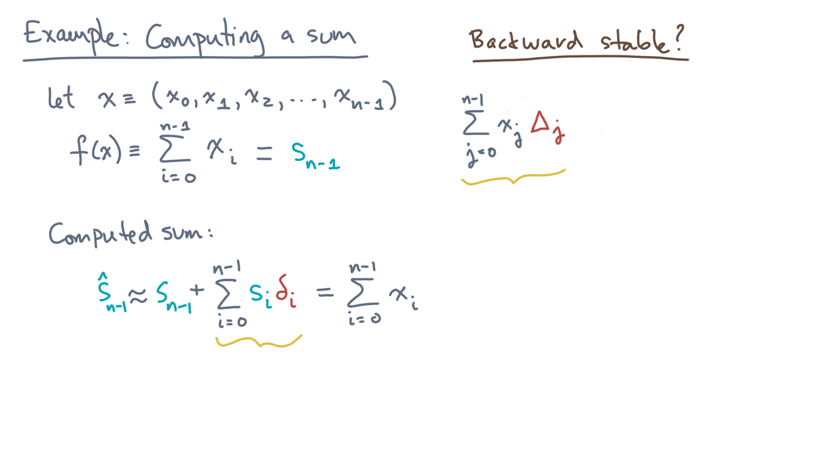
Notes:
Notice that there will be a common x-I terms.

Slide 29
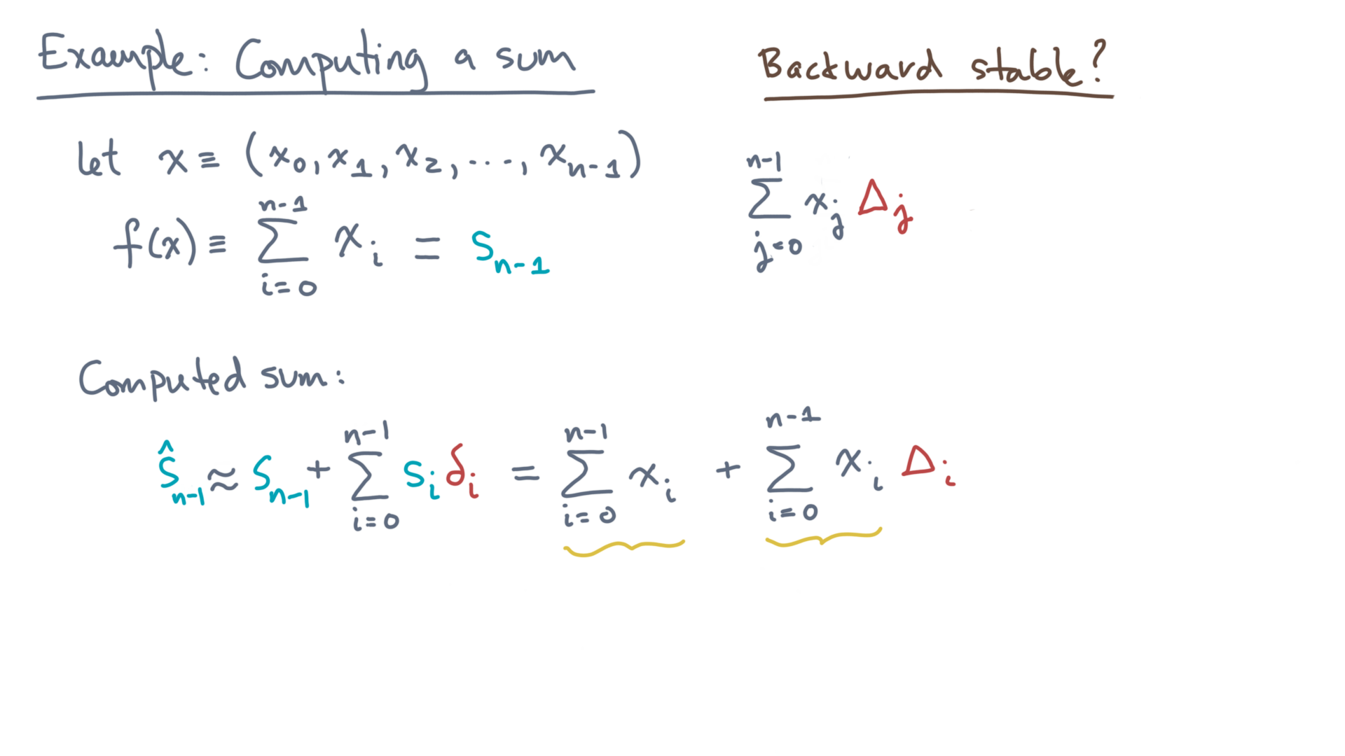
Notes:
Factoring it will reveal the form we are after!

Slide 30
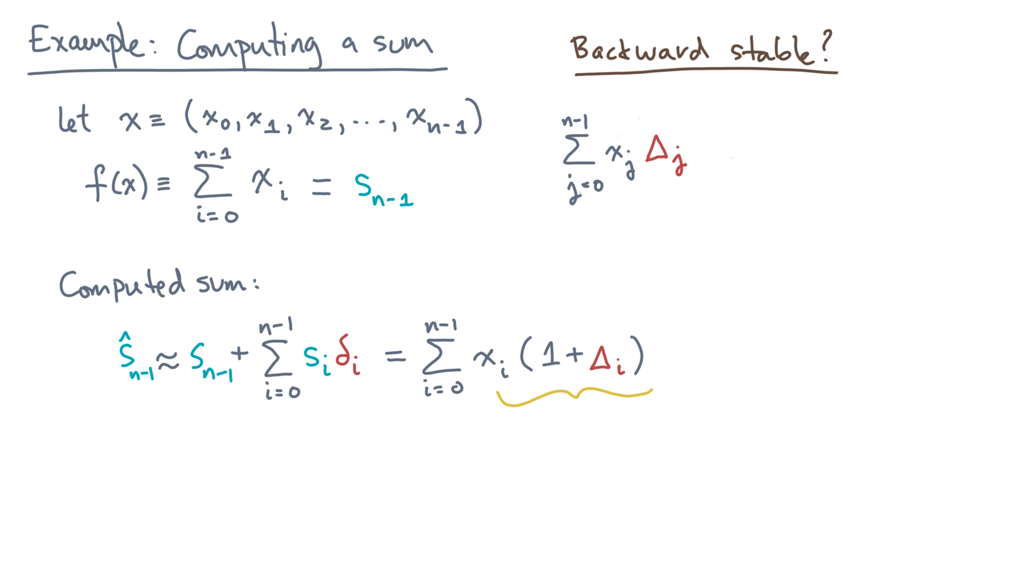
Notes:
Think about what this shows.
The computed sum is a sum of the input values, with each x-i perturbed by capital Delta-i.

Slide 31
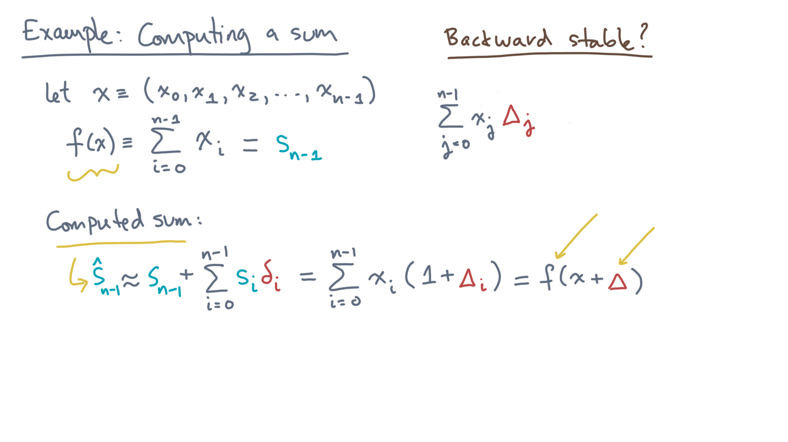
Notes:
That’s exactly the form of a backward stable algorithm.

Slide 32
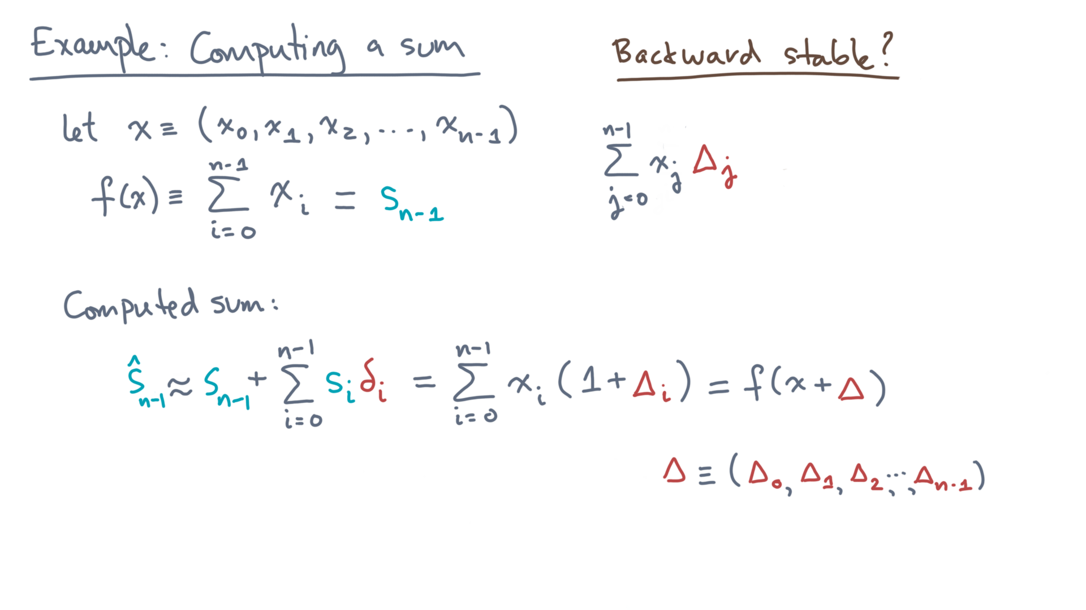
Notes:
By way of notation, capital Delta is the vector of the individual error terms.
To establish backward stability, just one question remains.

Slide 33
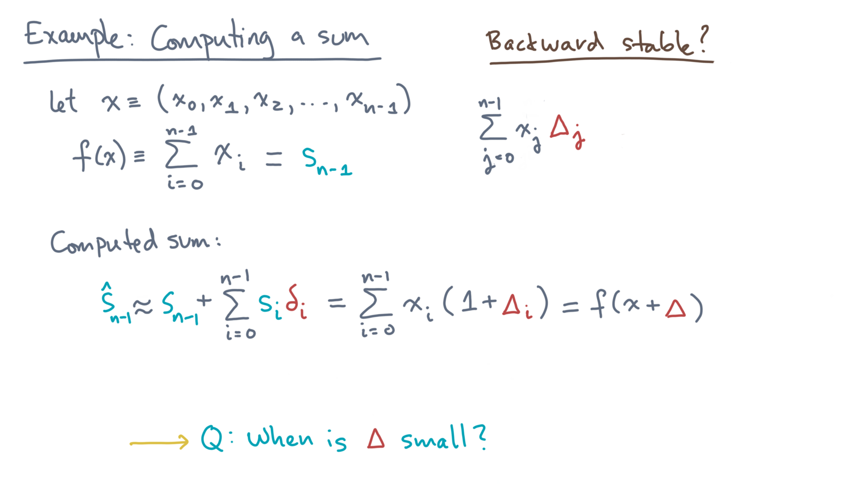
Notes:
When may we regard “Delta” as being small?

Slide 34
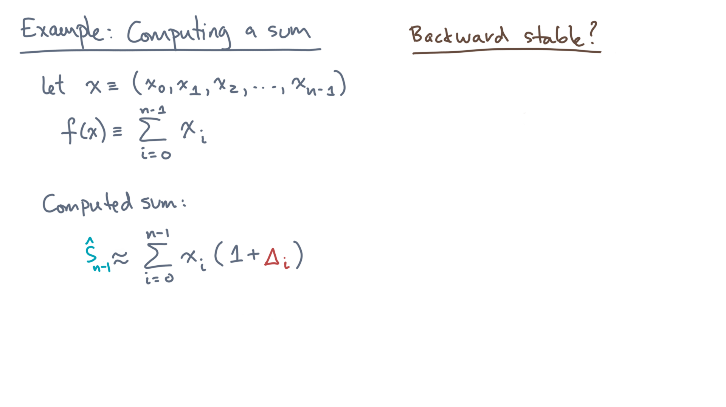
Notes:
Let’s tackle that question now.
First, how large could any capital Delta-i be?

Slide 35
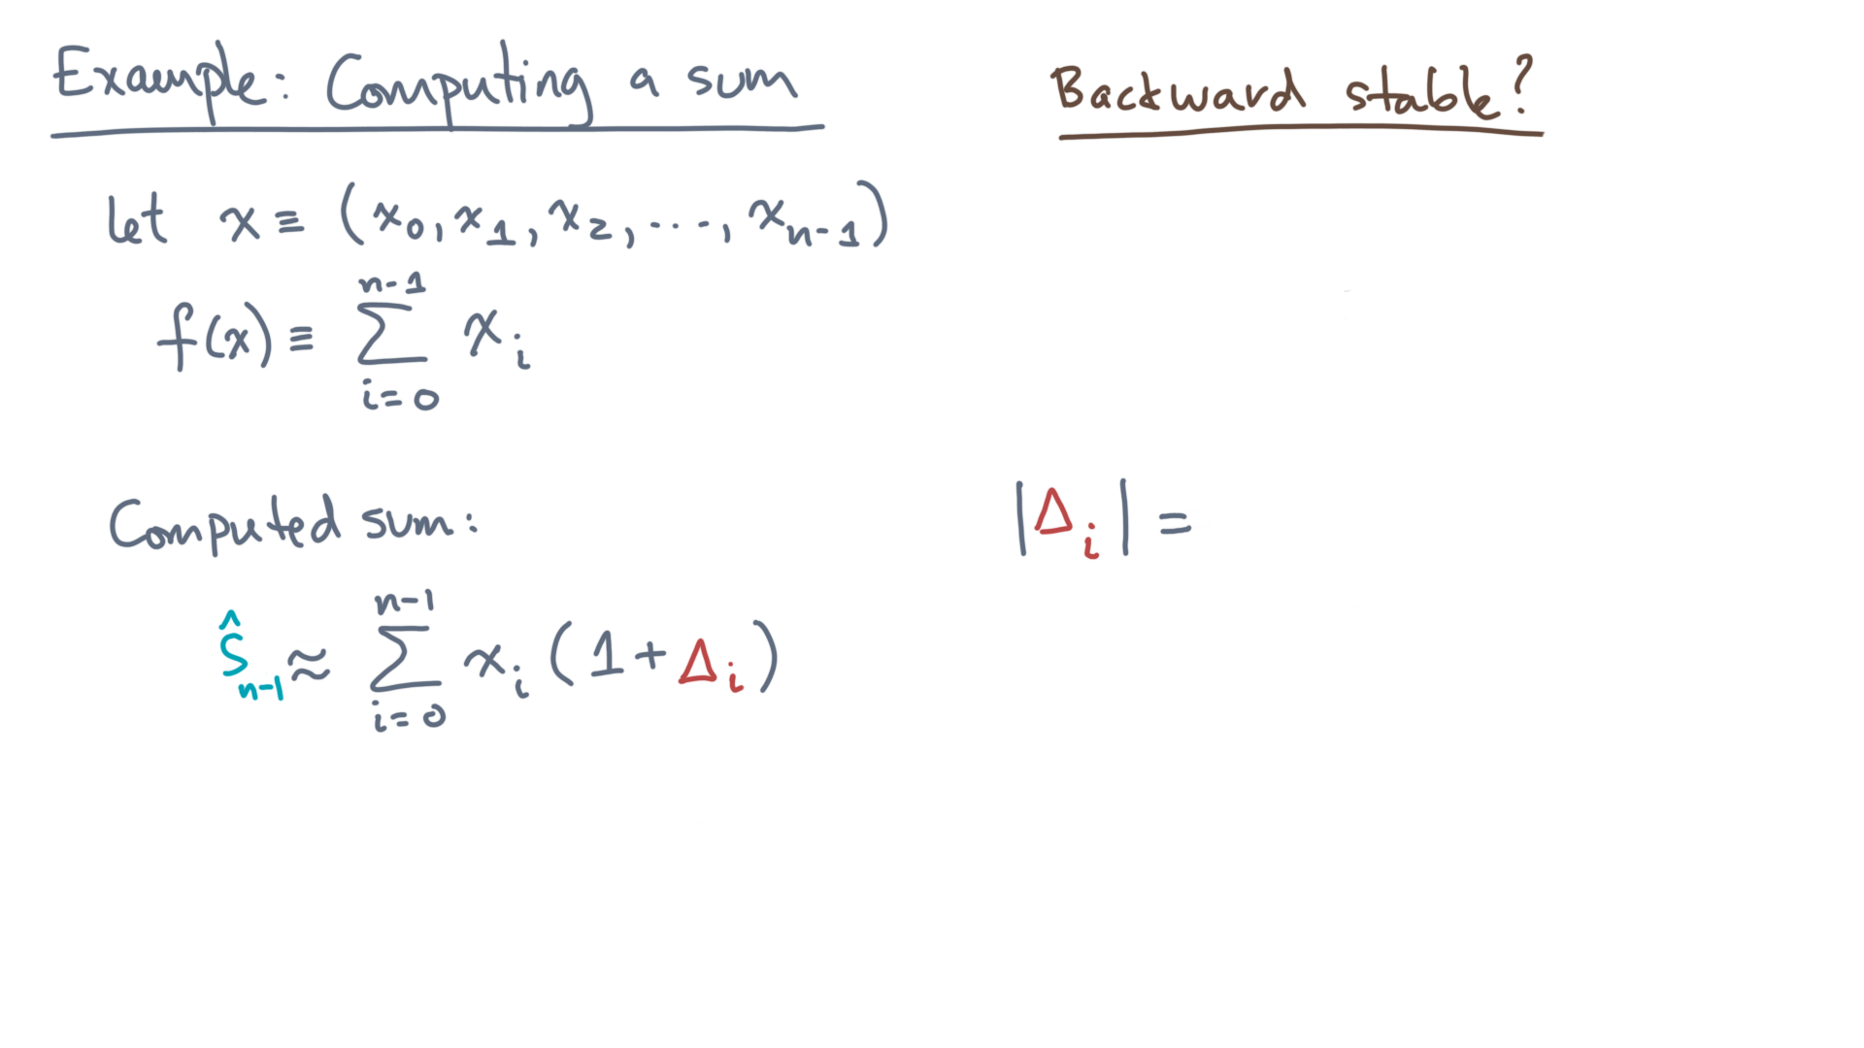
Notes:
Recall its definition.

Slide 36
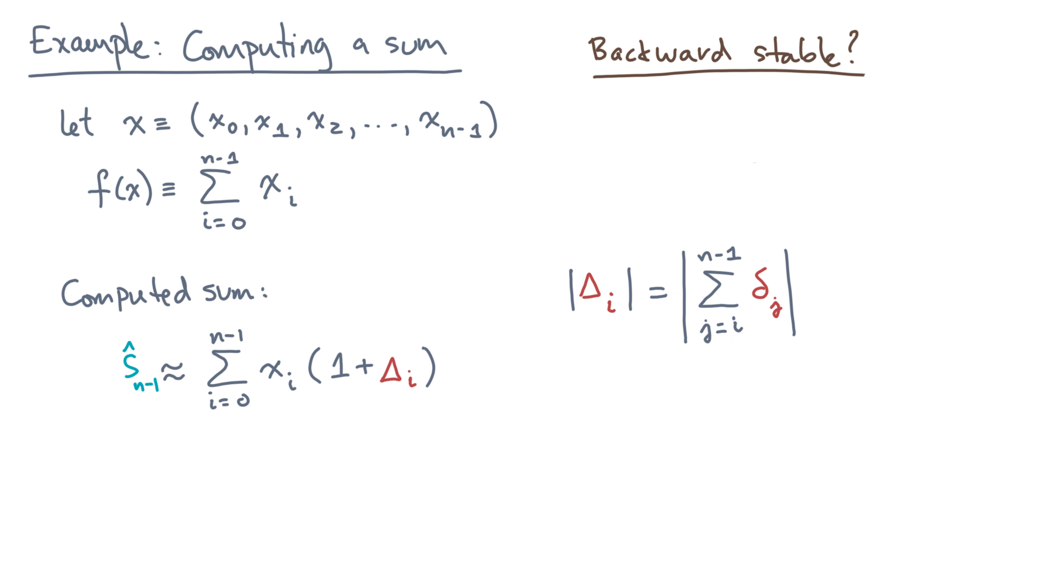
Notes:
It’s the sum of the last n-minus-i rounding errors.
Next, let’s move the absolute values inside the sum.

Slide 37

Notes:
Notice the equality is now only an upper-bound.
This fact is just an application of the triangle inequality.
The nice thing is what comes next.

Slide 38
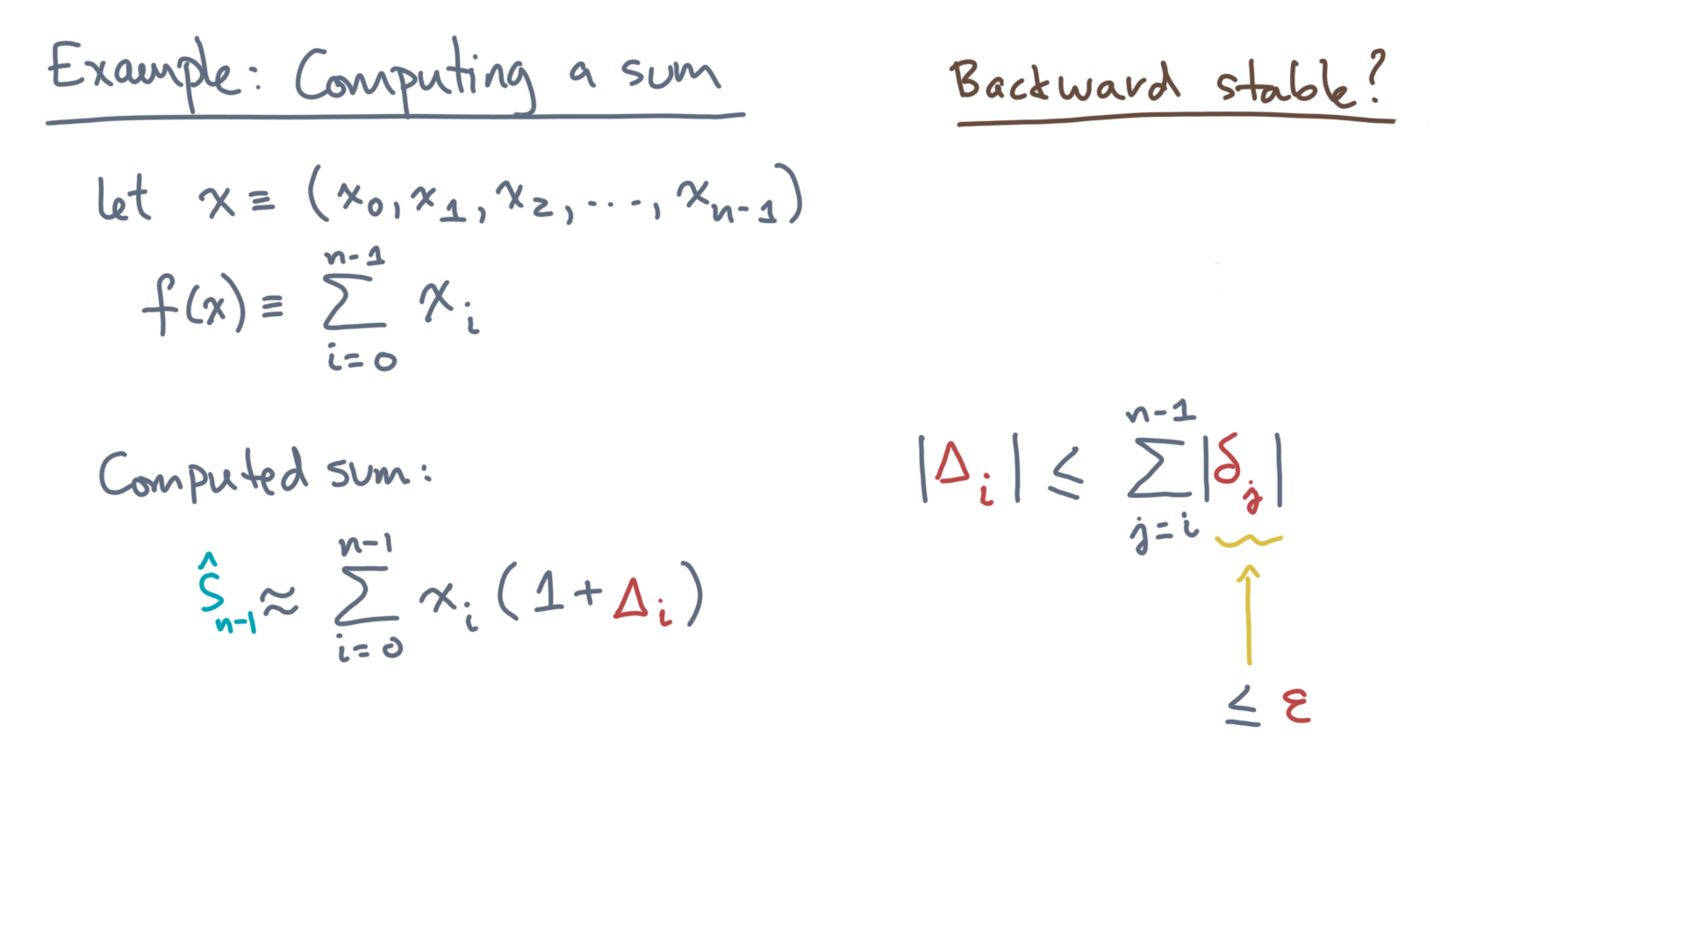
Notes:
The absolute value of a rounding error is at most machine epsilon.

Slide 39
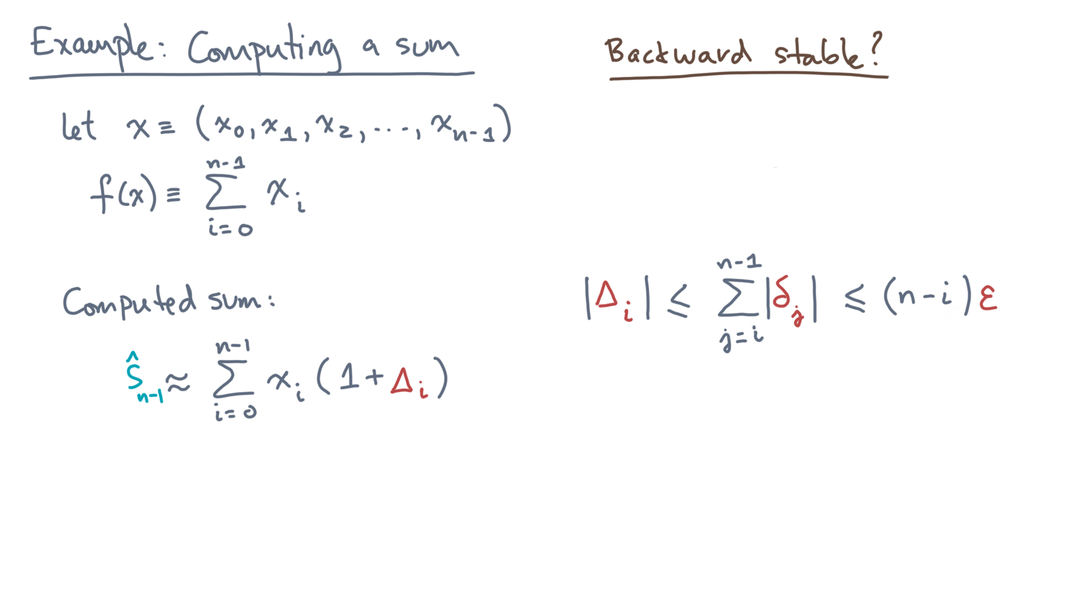
Notes:
Thus, capital Delta-i is at most n minus i times epsilon.

Slide 40
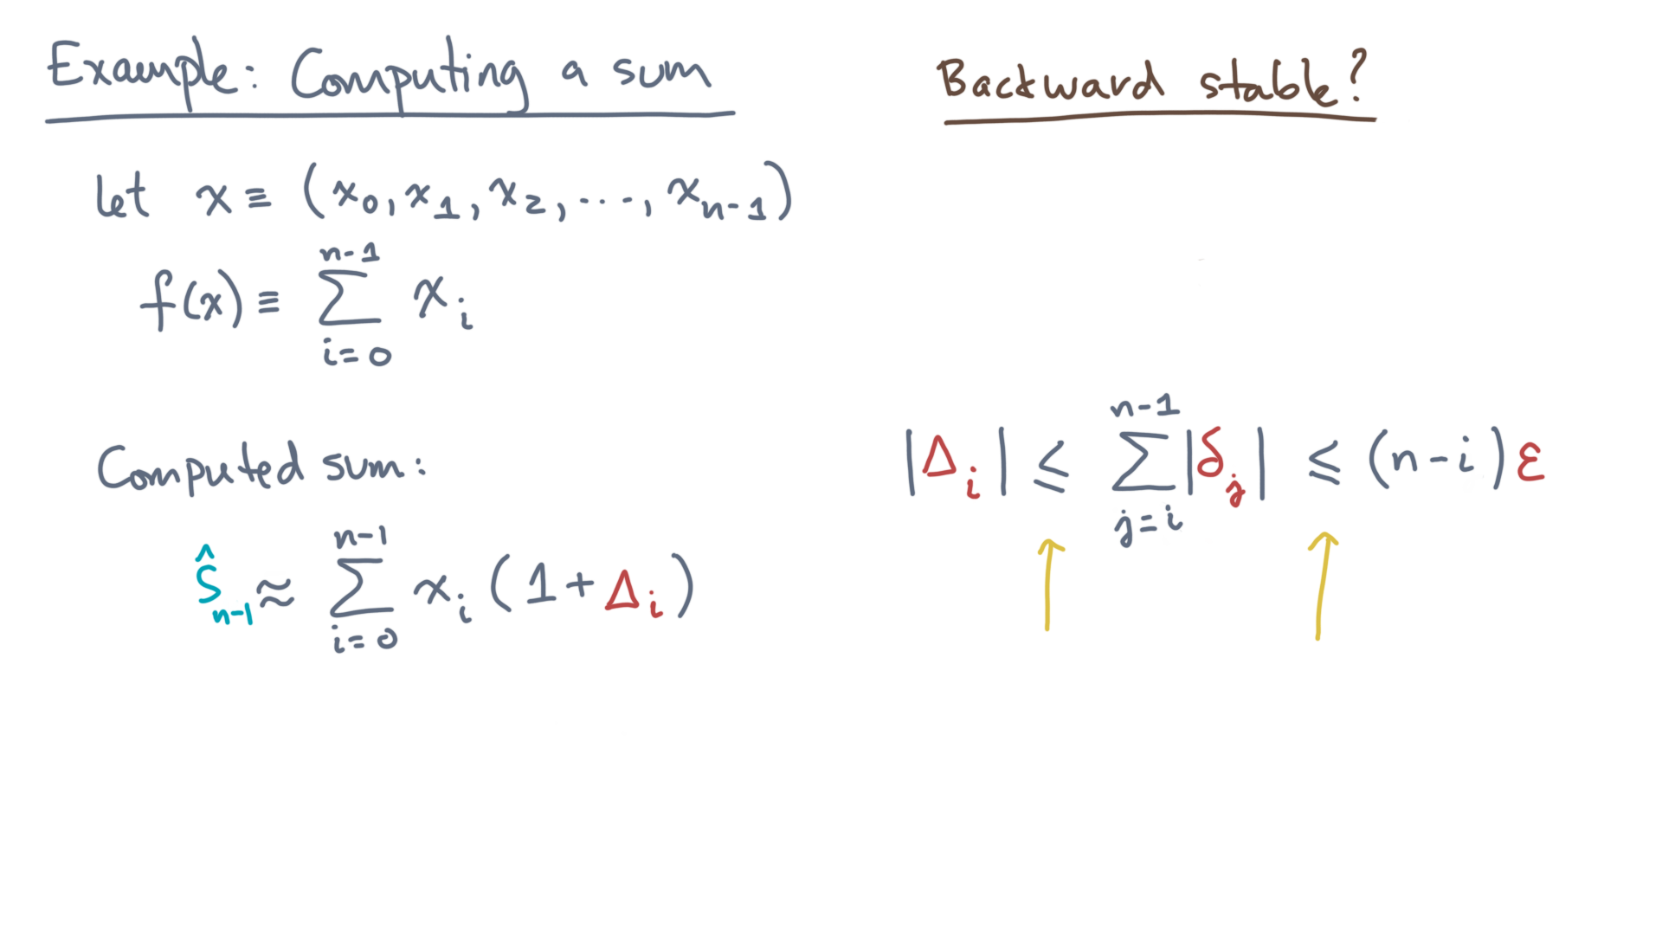
Notes:
Note that we invoked an upper-bound twice.
That means the bound on the right-hand side is likely to be pessimistic.

Slide 41
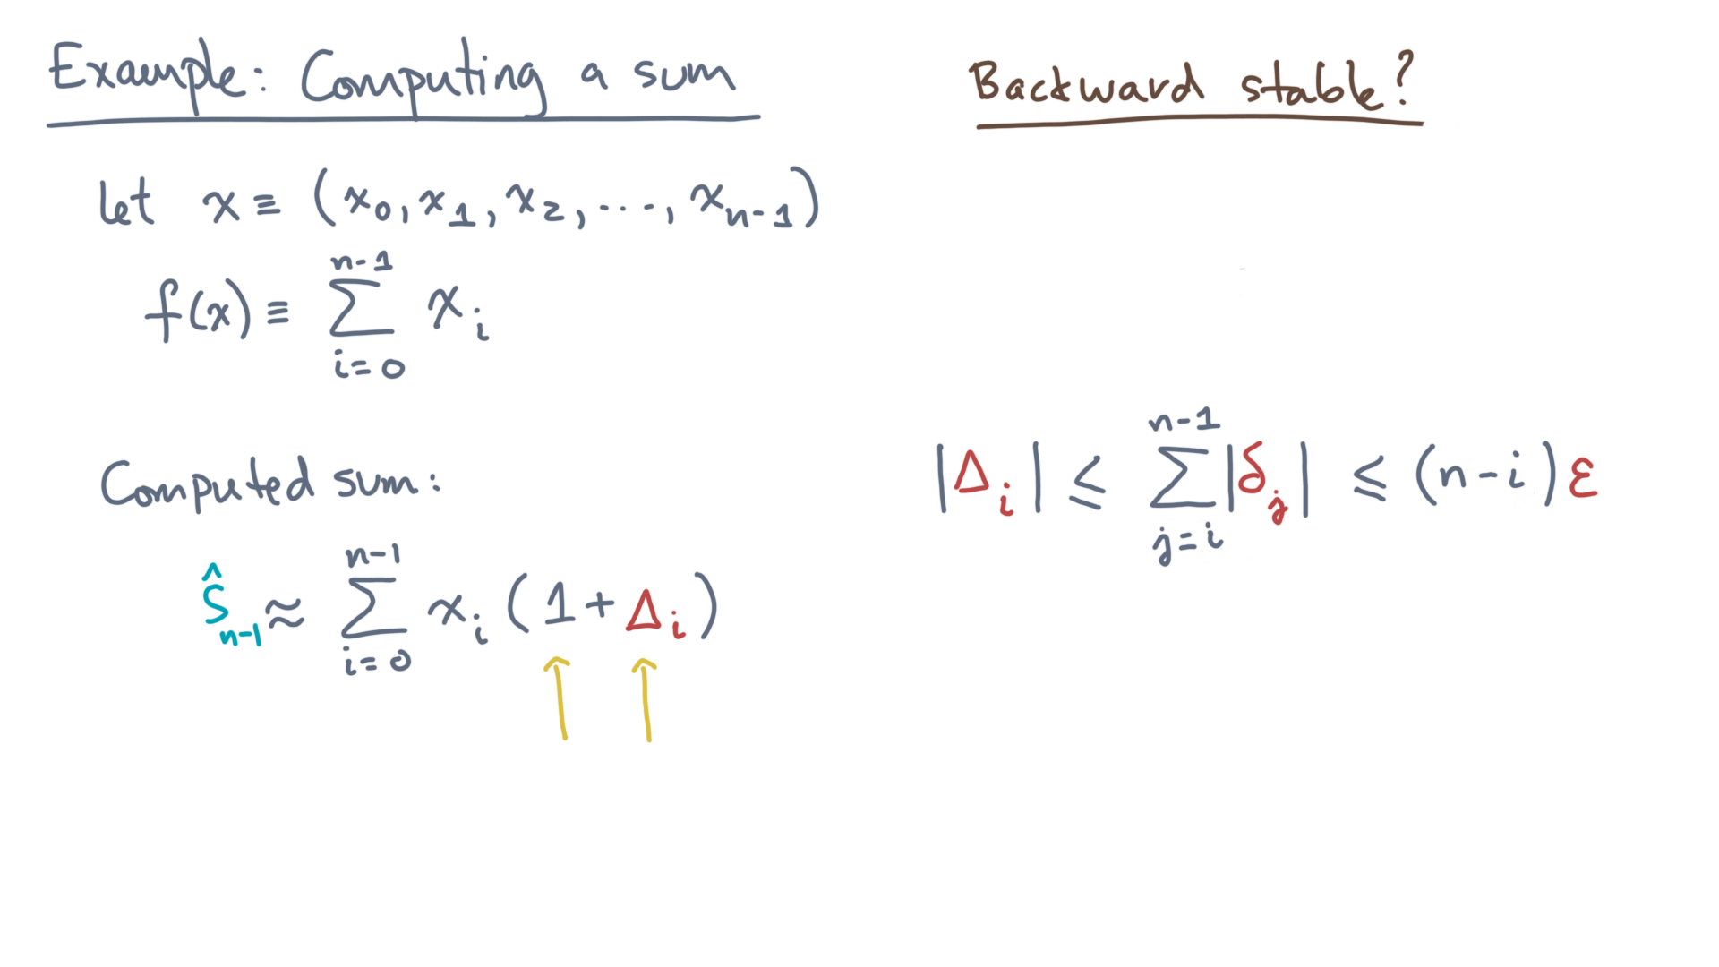
Notes:
So can we now conclude under what conditions the algorithm is backward stable?

Slide 42
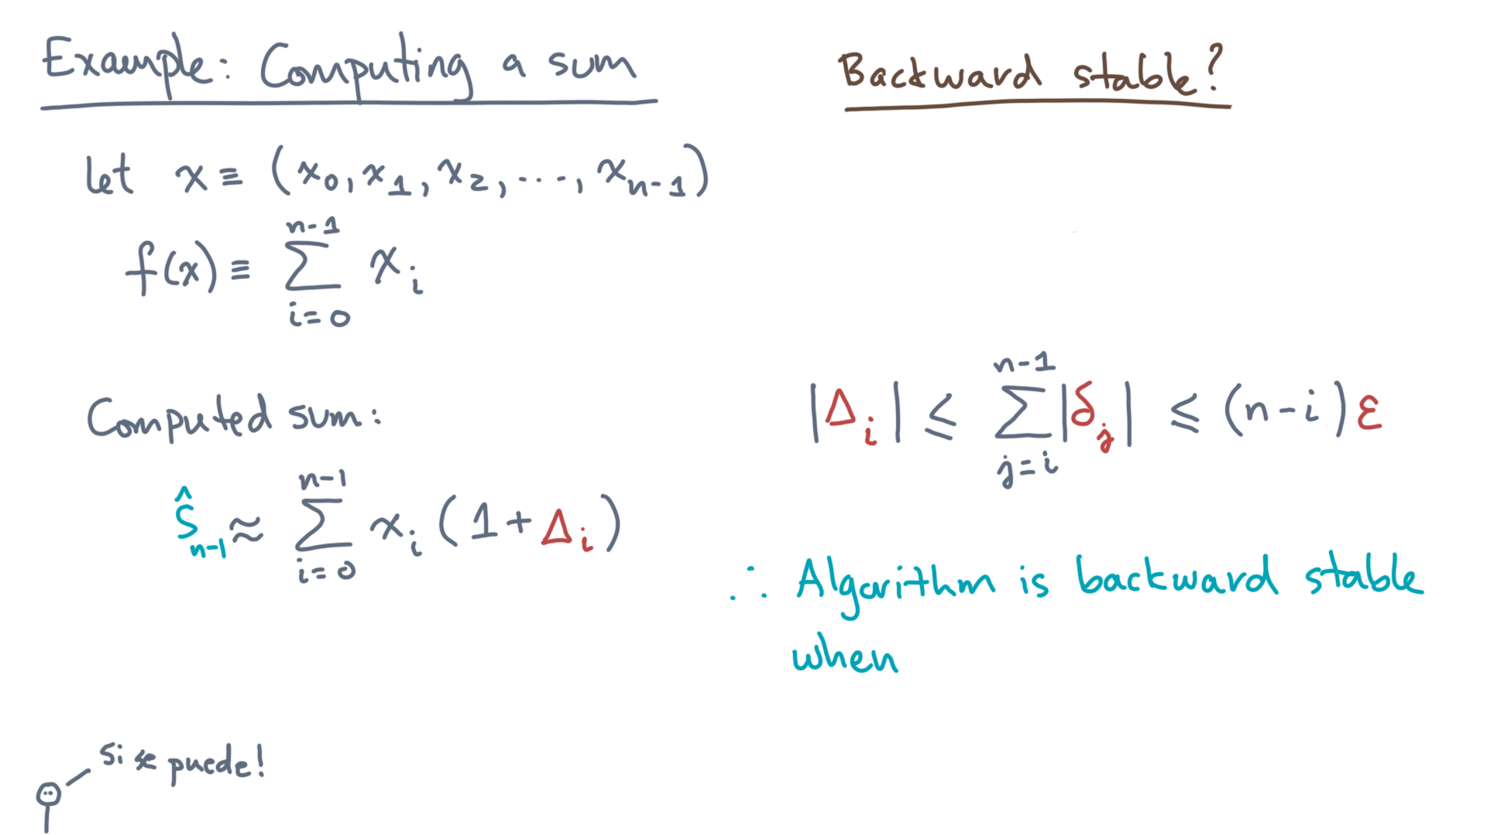
Notes:
Yes we can!
The largest capital Delta-i can be is n times epsilon.

Slide 43
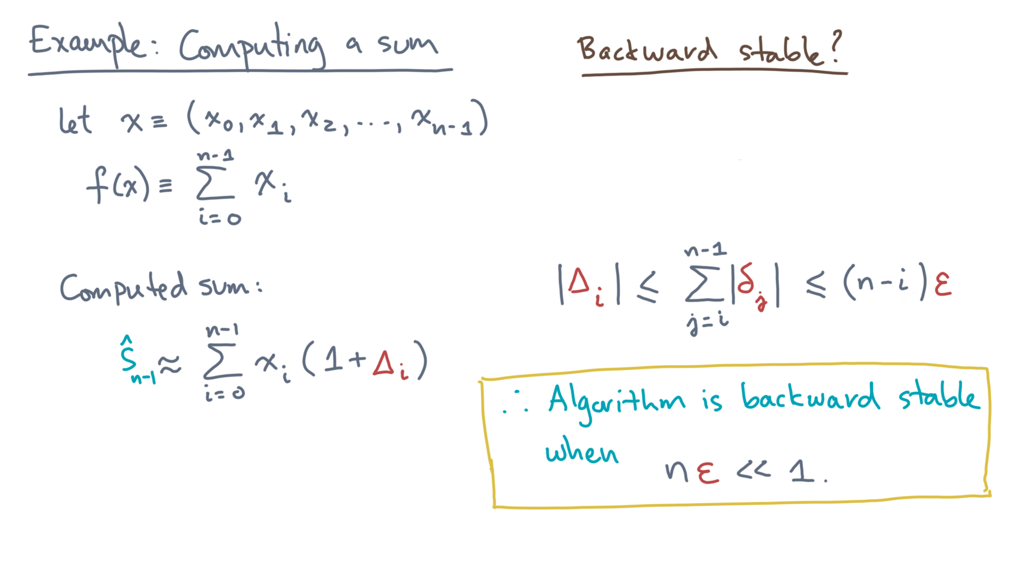
Notes:
So our algorithm is backward stable when n times epsilon is much less than 1.
That’s it!

Slide 44
Notes:
Okay, I guess I shouldn’t be a jerk and say, “that’s it!”
Because in fact, even if it wasn’t conceptually difficult, it *was* incredibly tedious.
But the good news is that you don’t always need to do this level of analysis.
Now that we’ve done it for a sum, you can just use the result in any algorithm that uses sums as a building block.
To give you a feel for that, we’ve prepared some exercises and a short lab notebook for you to complete.
So hopefully what may have seemed tedious will seem more natural and useful in practice.

